Slide 1
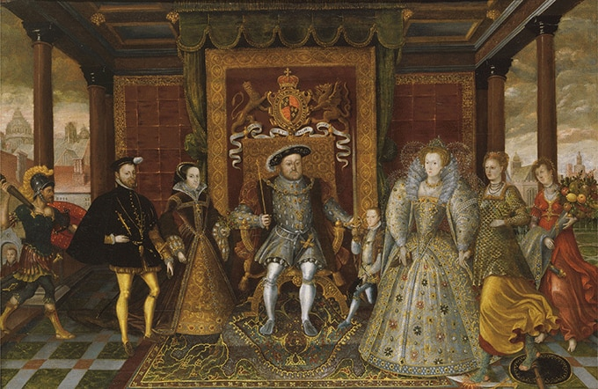
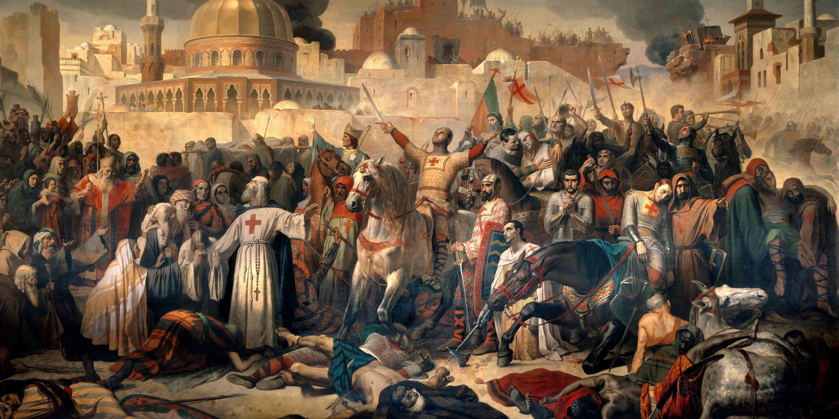


Name:

Slide 2

A Level History
The purpose of this transition booklet is to boost your readiness for A level History by ….
• Encouraging you to begin to explore periods of History that will be new to you.
• Understanding that History is about considering different views, not just memorizing facts!
• Having the chance to familiarise yourself with key concepts ahead of Year 12.
In Year 12 we will be looking at two main periods of History. The Tudors and the Crusades. These will be brand new and exciting topics for you – something a little bit different that you won’t have done before! First of all to prepare you need to find out the following about these periods:
Tudors (1485-1603)
In this period….
Who was on the throne of England? (more than one!)
What did people believe about religion?
Which countries were powerful during this period?
How did people travel?
What did people do in their spare time?
Crusades (1095-1193)
In this period….
Who was on the throne of England? (more than one!)
What did people believe about religion?
Which countries were powerful during this period?
How did people travel?
What did people do in their spare time?

Slide 3

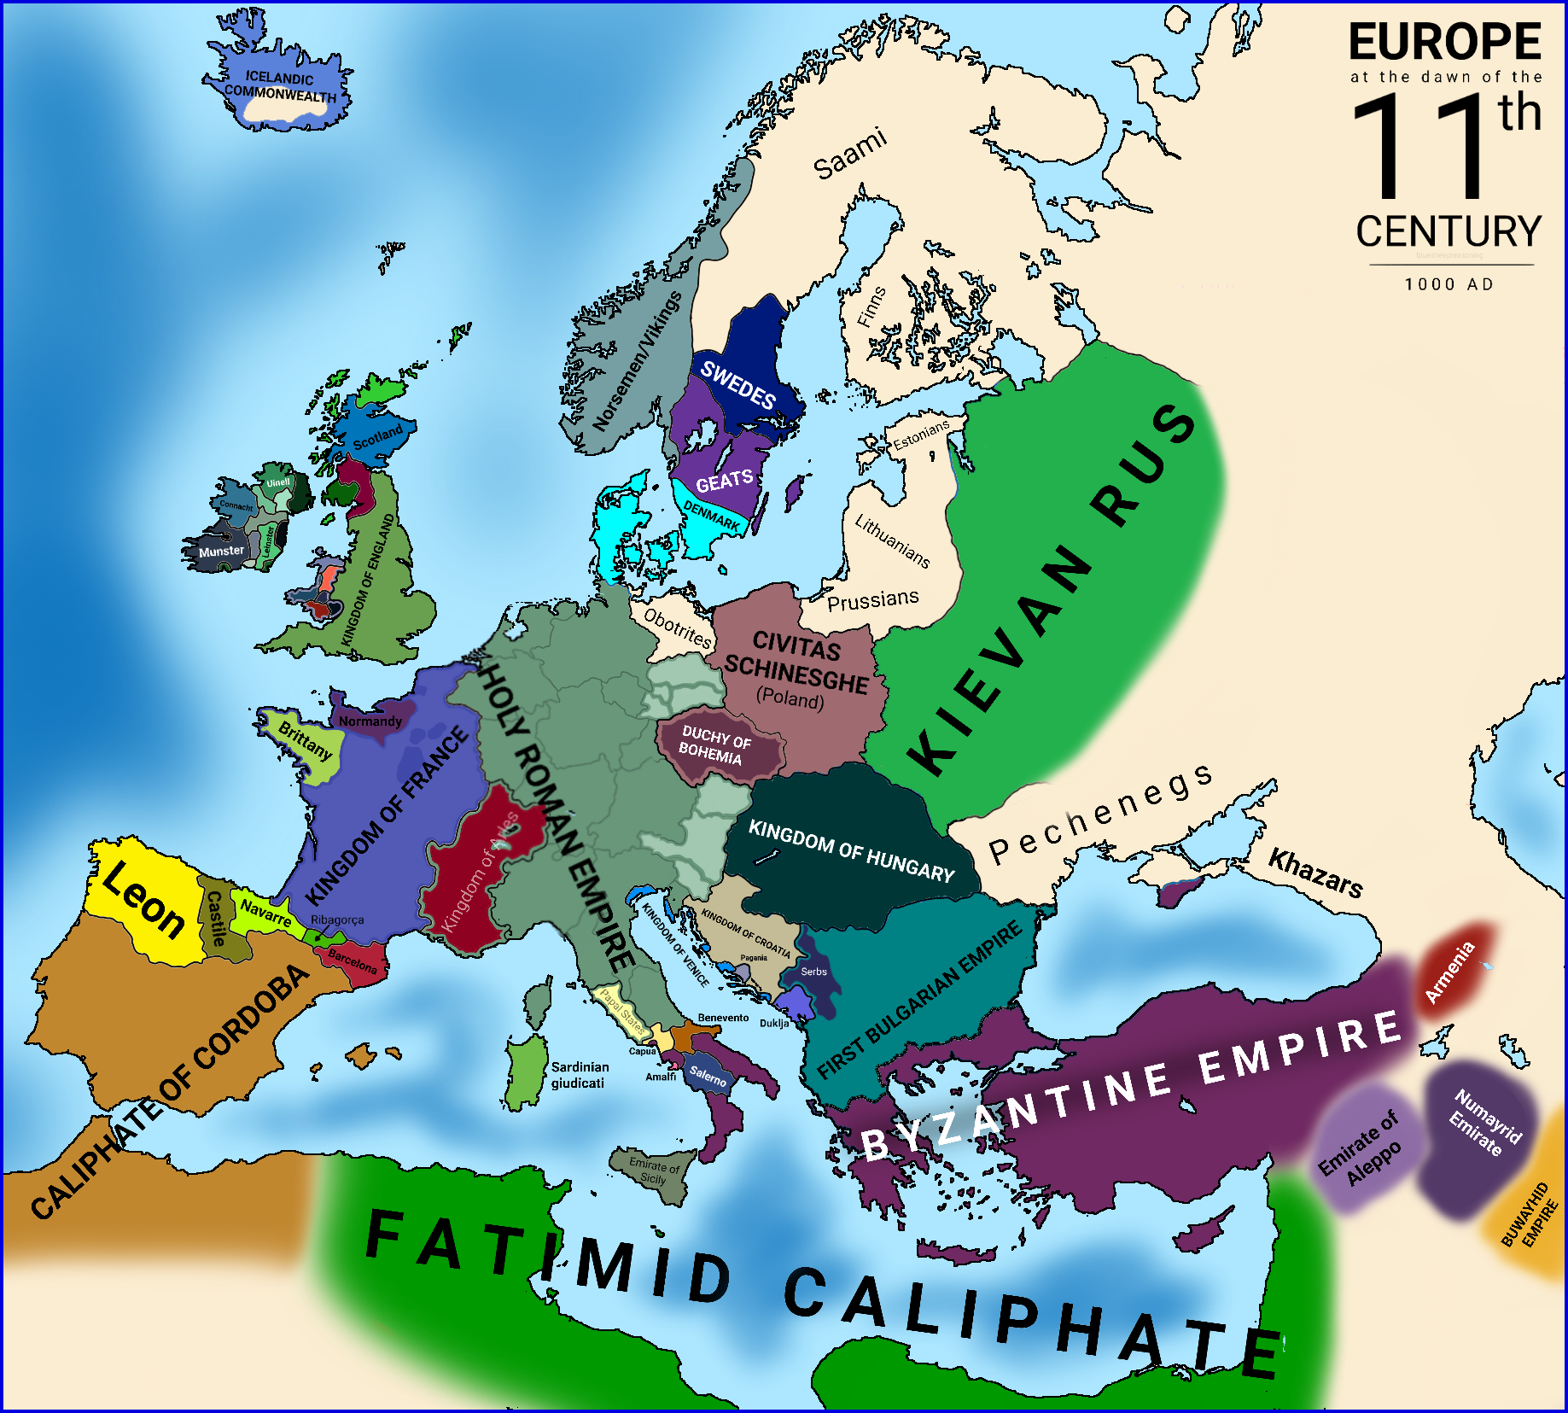
For the Crusades topic it will be important to get to know what the world looked like in the 11th Century.
Look at the map above, then write a short summary for each of the following. Consider who led it, where it was, how it was organised and any other important facts
Byzantine Empire
________________________________________________________________________________________________________________________________________________________________________________________
________________________________________________________________________________________________________________________________________________________________________________________
Holy Roman Empire
________________________________________________________________________________________________________________________________________________________________________________________
________________________________________________________________________________________________________________________________________________________________________________________
Fatimid Caliphate
________________________________________________________________________________________________________________________________________________________________________________________
________________________________________________________________________________________________________________________________________________________________________________________

Slide 4
Thereupon, we crossed the sea and went up to Nicaea. For the Duke, Bohemund, and the other princes had preceded the Count and were engaged in the labors of the siege. The city of Nicaea is very strongly fortified by nature, as well as by art. It has on the west a very large lake flowing up to the wall; on the remaining three sides is a moat filled with the overflow of certain little streams; in addition, it is encircled by walls so high that neither the assaults of men nor the attacks of any machine are feared.
Accordingly, this city, such as we have described, was besieged by Bohemund from the north, by the Duke and the Alemanni from the east, by the Count and Bishop of Puy from the middle. After this, machines were constructed and the wall attacked in vain, for it was very firm against us and was valiantly defended by arrows and machines. So we fought five weeks with no result. At length, through God's will, some men of the household of the Bishop and the Count dangerously enough approached the comer tower which faced the east, they began, after a struggle, to undermine one of the towers and by digging threw it to the ground. However, the wall was rebuilt during the night, and this rendered our former labor vain. In the end city, terrified with fear, was compelled to surrender.
When the city was captured, the Christians took all the gold, silver, horses, and goods within.
Source:
August. C. Krey, The First Crusade: The Accounts of Eyewitnesses and Participants, (Princeton: 1921), 103-105
Task: Read the source above. It is about the capture of a city called Nicaea. This was a city captured by the Crusaders. Write a short paragraph explaining what you can learn about this battle from the source above. _______________________________________________________________________________________________________________________________________________________________________________________________________________________________________
_______________________________________________________________________________________________________________________________________________________________________________________________________________________________________
_______________________________________________________________________________________________________________________________________________________________________________________________________________________________________
_______________________________________________________________________________________________________________________________________________________________________________________________________________________________________

Slide 5

OCR Later Tudors
Bingo
Attempt a minimum of 4 activities before September
Read a short article on Henry VII’s consolidation of power and list
Draw and label a Tudor government structure (Privy Council, monarch, Parliament).
Research and list 4 key features of the Tudor court.
Watch a documentary on Henry VIII’s break with Rome and write 3 key causes.
Read a historian’s interpretation of Henry VIII’s foreign policy and summarise the argument.
Create an A4 revision sheet on Tudor rebellions (e.g. Pilgrimage of Grace), using case studies like Fountains Abbey (visit or virtual tour).
Watch a documentary such as BBC: Henry VIII: Mind of a Tyrant and write 3 key causes of the Break with Rome.
Read the following,
John Guy – Tudor England
Read a chapter from Eamon Duffy – The Stripping of the Altars and note 4 consequences of the Dissolution of the Monasteries.
cards
Watch a video/documentary on the Spanish Armada and write 3 reasons England won; link to Tilbury Fort (Elizabeth’s speech site).
Purchase: My Revision Notes: OCR AS/A-level History: England 1547–1603: the Later Tudors
Listen to, History Extra podcast on the Tudors
Visit an online archive such as The National Archives (Kew) or British Library Tudor collections, find one primary source, and summarise it.
.
Listen to a podcast such as BBC In Our Time (Henry VIII / Elizabeth I)
Create a mini timeline of key events 1485–1603,
Read, David Loades – Mary Tudor: A Life

