Slide 1
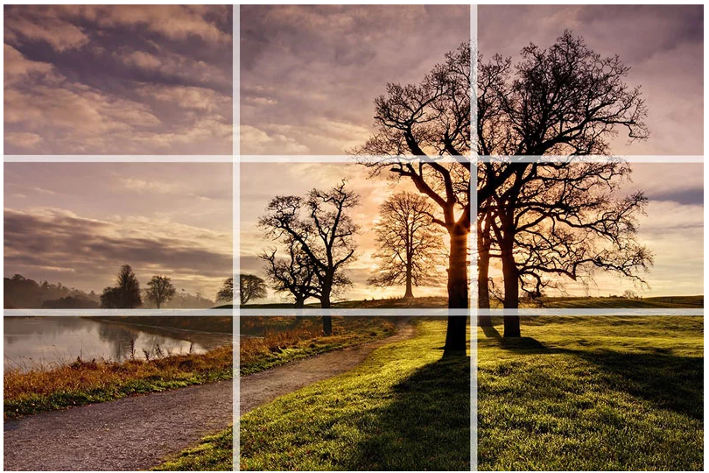
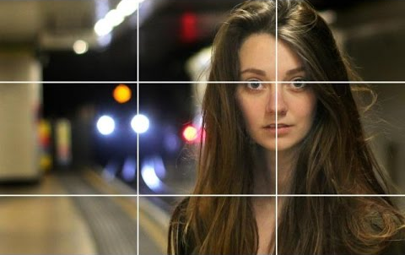
Composition
In the visual arts, composition is the placement or arrangement of visual elements or 'ingredients' in a work of art ... The term composition means 'putting together' and can apply to any work of art, from music to writing to photography.
Rule of Thirds
The rule of thirds is very simple. You divide the frame into 9 equal rectangles, 3 across and 3 down as illustrated to the right.
The idea is to place the important element(s) of the scene along one or more of the lines or where the lines intersect. We have a natural tendency to want to place the main subject in the middle. Placing it off centre using the rule of thirds will more often than not lead to a more attractive composition.
In this photo, the horizon is placed roughly along the bottom third of the frame and the biggest and closest trees along the line to the right. The photo wouldn’t have the same impact if the larger trees had been placed in the centre of the frame. As you can see on the right these rules also apply to

Slide 2
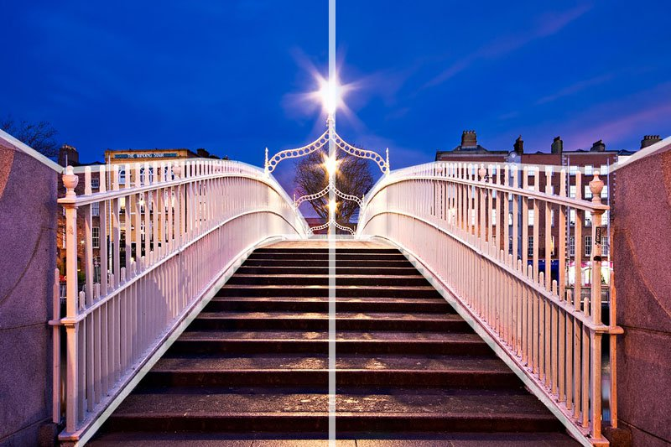
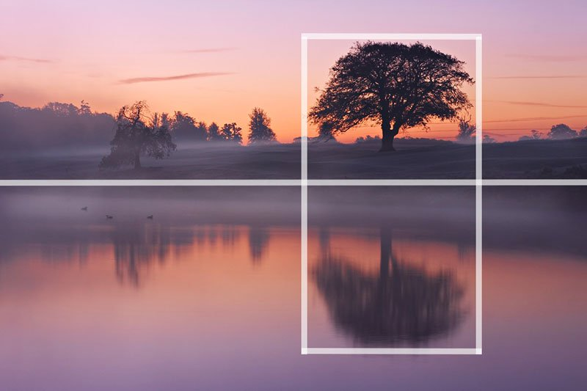
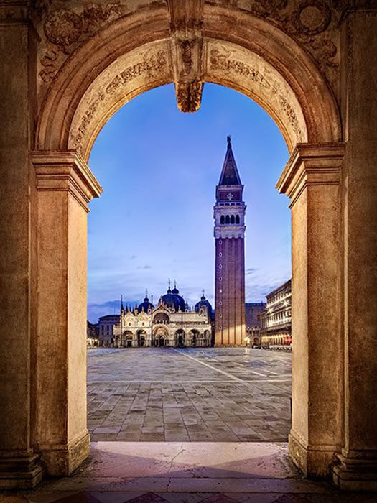
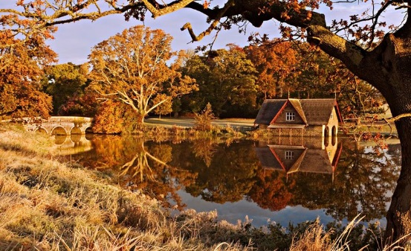
Theory
Centred Composition and Symmetry
There are times when placing a subject in the centre of the frame works really well. Symmetrical scenes are perfect for a centred composition.
Scenes containing reflections are also a great opportunity to use symmetry in your composition. In this photo, there is a mix of the rule of thirds and symmetry to compose the scene. The tree is positioned off centre to the right of the frame but the perfectly still water of the lake provides the symmetry.
Frame Within the Frame
Look for elements such as windows, arches or overhanging branches to frame the scene with. The ‘frame’ does not necessarily have to surround the entire scene to be effective. Look for elements such as windows, arches or overhanging branches to frame the scene with. The ‘frame’ does not necessarily have to surround the entire scene to be effective.
Frames don’t have to be man-made objects such as arches or windows. This time, the tree trunk to the right and the overhanging branch to create a frame around the scene.

Slide 3
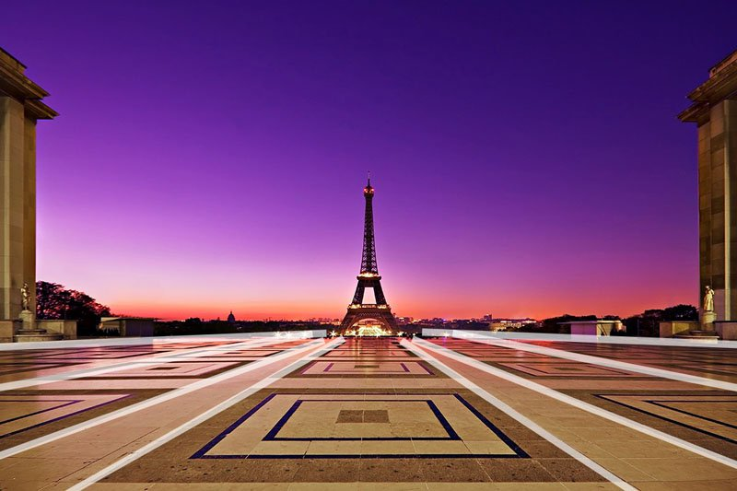
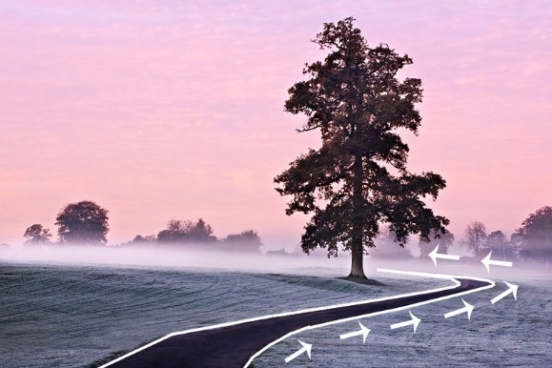
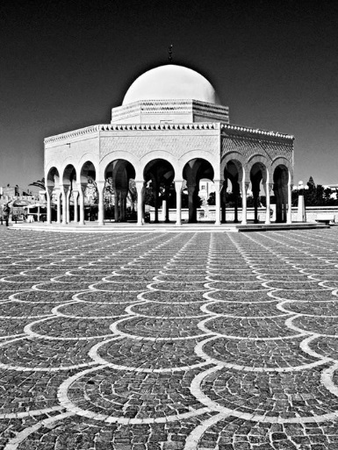
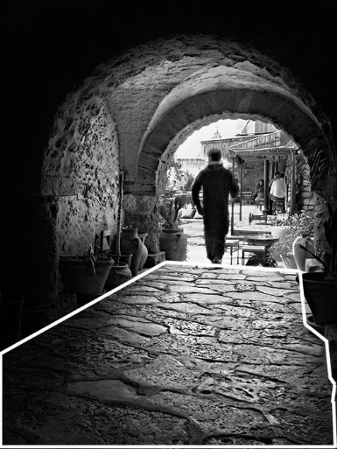
Theory
Leading Lines
Leading lines help lead the viewer through the image and focus attention on important elements. Anything from paths, walls or patterns can be used as leading lines. Take a look at the examples.
In this photo of the Eiffel Tower, patterns on the paving stones are used as leading lines. The lines on the ground all lead the viewer to the Eiffel Tower in the distance.
Leading lines do not necessarily have to be straight as illustrated by the picture above. In fact curved lines can be very attractive compositional features. In this case, the path leads the viewer to the right of the frame before swinging in to the left towards the tree.
Patterns and Textures
Human beings are naturally attracted to patterns. They are visually attractive and suggest harmony. Patterns can be man made like a series of arches or natural like the petals on a flower. Incorporating patterns into your photographs is always a good way to create a pleasing composition. Less regular textures can also be very pleasing on the eye.

Slide 4
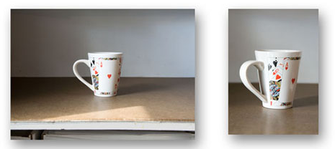
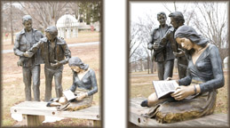
Composition
Have a look at the images then read through the text.
When you look at these images it can be hard to tell which has better composition. In all honesty, you could make arguments for and against which has the strongest composition but that doesn’t change the fact that generally, the images on the right would be considered better composition. This is because when you look at how the photographer has changed their angle, you can see that each time they have got on the same angle as the subject to show more detail and to draw emphasis to what the focus of the image is. The photographer has also done a crop on the images without using a computer. So they have got closer to the subject, maybe zoomed in or out and really considered how the background of the image looks. You have to do this in order to decided what the focus of the image is. If you have a really busy background it might distract the viewer causing them to lose focus on the story you are trying to communicate.

Slide 5
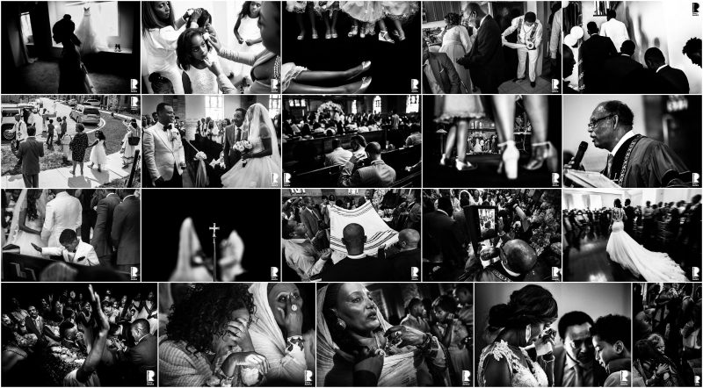
Photo story
Have a look through the images below. This is what photographers call a photo story
You can tell from these image that the story in these photos is a wedding. You can tell this because of the key shots (bride and groom) that communicate it’s a wedding, the emotions, the religious symbols and of course the wide shots that show the number of people in attendance. To the impartial viewer, it seems obvious that the guests are attending a wedding but that’s because the photographer has done a very good job of communicating a narrative through still images.

Slide 6
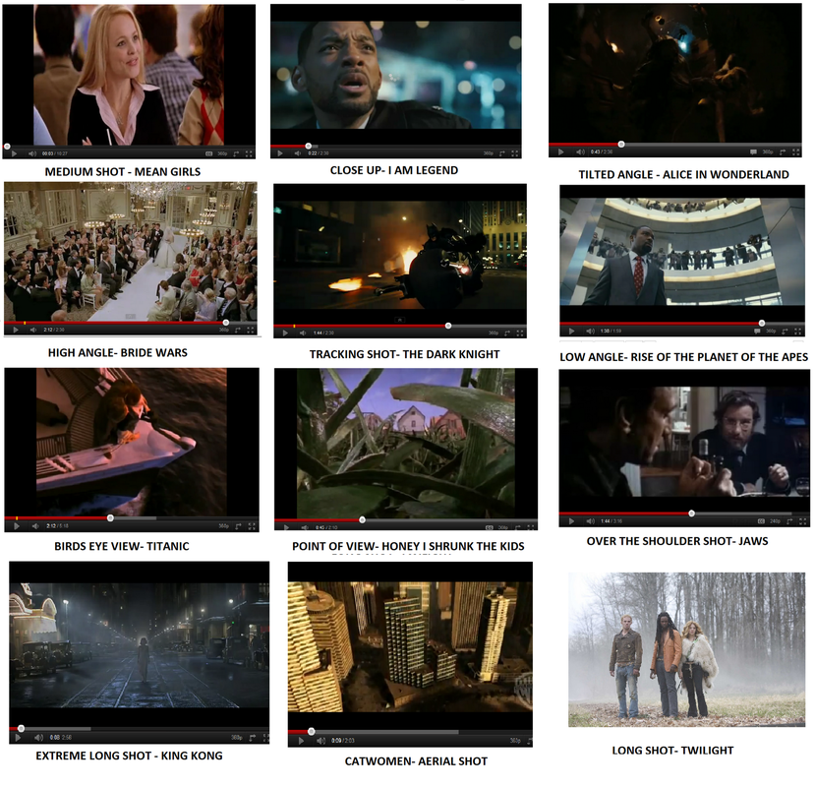
Composition
Task: Use the still image to tell a story. For this you will need to take multiple shots from different angles that communicate a story to the viewer.
Task
So with photostory and composition in mind, I want you to take a series of images that tell a story. The narrative (story) can be whatever you like but you need to think about how your images may communicate different things dependant on your angle, subject and what’s in shot. Once you have your images taken, have a look at arranging you images so they tell a story. Think about how each shot may represent different parts of a story then put them together in an order. Remember to experiment with lots of different angles whilst shooting and try to get a clear idea of what story you are trying to tell

