Slide 1



Park Hall Academy
Transition Booklet: BTEC Enterprise and Entrepreneurship 2020-21
Name:__________________

Slide 2
What will I be studying?
Learners taking this qualification will study three mandatory units covering the following areas:
•Enterprise and Entrepreneurs
•Personal and Business Finance
•Developing a Marketing Campaign
And Learners will study: Social Enterprise as the optional unit.
Unit 1:Enterprise and Entrepreneurs
Unit type: Internal
Guided learning hours:90
Learners study enterprise and the mindset of entrepreneurs, exploring the risks, opportunities and constraints of starting an enterprise. Entrepreneurs are those who take that first brave step, identify an opportunity and start their own enterprise. They have a clear vision and the determination to put their ideas into practice. In this unit, you will gain an overview of the importance of both enterprise and entrepreneurs to the local and national economy. You will explore their creativity and mindset as you look at real-life enterprise and entrepreneurs, and investigate the skills required to be successful. You will also look at the risks, opportunities and constraints faced by entrepreneurs in setting up their venture, assess the feasibility of a range of potential enterprise opportunities and then develop and present one idea for a local enterprise.
Unit 2:Developing a Marketing Campaign
Unit type: External
Guided learning hours:90
Learners will gain skills relating to, and an understanding of, how a marketing campaign is developed. Marketing is a dynamic field central to the success of any business. You will gain an understanding of how a marketing campaign is developed. You will explore different stages of the process that a business goes through when developing its campaign and develop your own campaign for a given product/service.This unit will give you an insight into how important marketing is to business. It will enable you to make an informed choice as to whether you want to specialise in marketing in employment, training or higher education
Unit 3:Personal and Business Finance
Unit type: External
Guided learning hours:120
Learners study the purpose and importance of personal and business finance. They will develop the skills and knowledge needed to understand, analyse and prepare financial information. This unit includes aspects of both personal and business finance. Personal finance involves the understanding of why money is important and how managing your money can help prevent future financial difficulties. It is vital you understand the financial decisions you will need to take throughout your life and how risk can affect you and your choices. This unit will also give you an insight into where you can get financial advice and support. The business finance aspects of the unit introduce you to accounting terminology, the purpose and importance of business accounts and the different sources of finance available to businesses. Planning tools, such as cash flow forecasts and break-even, will be prepared and analysed. Measuring the financial performance of a business will require you to prepare and analyse statements of comprehensive income and statements of financial position.This unit will provide a foundation for a number of other finance and business units and will help you to analyse profitability, liquidity and business efficiency. It will give you the knowledge and understanding to manage your personal finances and will give you a background to business finance and accounting as you progress to employment or further training.
Unit 7:Social Enterprise
Unit type: Internal
Guided learning hours:60
Learners research and develop an understanding of organisations trading for social purposes, gaining practical experience in planning and running a short social enterprise activity. In this unit, you will learn about social enterprise, an ethos that is growing around the globe and is gaining support from the public, private and voluntary sectors. The national body for social enterprise, Social Enterprise UK, has described Britain as being on the frontline of social enterprise activity compared with the rest of the world. Social enterprises compete in the marketplace and need to be well run to make money and achieve their social aims. They can vary from small community-owned village shops to large organisations delivering public services. You will explore what it is that makes them a success or a failure and will then engage in running a short social enterprise of your choice. This unit will help you to progress to employment through developing key employability skills, and to vocational training and higher apprenticeships or higher education by developing relevant knowledge and understanding.

Slide 3
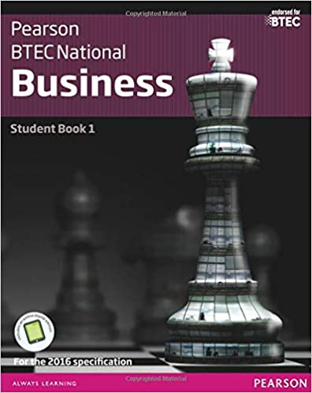
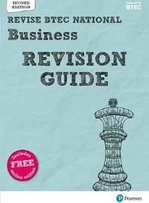



Recommended Reading and Television

Slide 4
Class Central are offering free business related course you might be interested in I have included a few examples below: https://www.classcentral.com/collection/ivy-league-moocs?subject=business
Name | Outline | Course Length
Introduction to Financial Accounting | Master the technical skills needed to analyse financial statements and disclosures for use in financial analysis, and learn how accounting standards and managerial incentives affect the financial reporting process. | 4 weeks long
Introduction to Marketing | You’ll learn key principles in - Branding: brand equity is one of the key elements of keeping customers in a dynamic world in which new startups are emerging constantly. - Customer centricity: not synonymous with customer service, customer centricity starts with customer focus and need-gathering. - Go-to-market strategies: understand the drivers that influence customers and see how these are implemented prior to making an investment. | 5 weeks long
The Global Financial Crisis | Introduction to The Global Financial Crisis The Common Causes of Financial Crises Housing and Mortgages | 11 weeks long
Financial Markets | An overview of the ideas, methods, and institutions that permit human society to manage risks and foster enterprise. | 7 weeks long

Slide 5
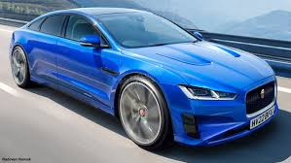
Coronavirus and Cash Flow
https://www.tutor2u.net/business/blog/coronavirus-and-cash-flow
Since the onset of the Coronavirus and the UK lockdown, one topic that has frequented the business pages is cash flow.
Liquidity pressures
With all but essential retailers closed, the majority of firms have seen the taps turn off overnight and revenue from cash sales plummet, putting extreme demands on cash reserves and creating liquidity pressures. Those that are reliant on cash sales and those who have money tied up in inventory and receivables no doubt felt the pinch quickly. Firms with an online presence will have clearly benefitted but the sudden increase in demand that some have seen, has resulted in websites only offering sales for limited hours in a day or even implementing queuing systems, to manage demand due to a lack of capacity. This in itself still creates a cash flow issue. We have also seen firms cancel dividend payments to shareholders in order to preserve working capital. This article goes into further detail regarding the insurer Aviva cancelling its 2019 dividend payment.
The impact on high street names
High street retailers were already struggling prior to the crisis. A report by the British Retail Consortium suggested that 2019 was the worse year for retailers in 25 years. Therefore in a sector that was already struggling, the crisis couldn't have come at a worse time. According to an article in The Times on the 10th April, Callum Jones wrote that the projected cash flow of 34 leading retailers was set to fall into negative territory. Some of these retailers include high street names such as: JD Sport, Dixons Carphone and Pets at Home. This was based on modelling from a consultancy firm that forecasted a 70% fall in sales. Post-crisis, what will the high street look like? For those that survive, how will their operations be affected by the lack of cash?
Planes and Automobiles
Airports and airlines have also been some of the hardest hit. As countries closed their borders, fleets of planes were grounded and along with that, revenue streams. In an article in the Economist, it was put forward that three quarters of airlines couldn’t cover costs beyond three months. Some of the biggest airlines have managed to secure credit lines from banks to support their working capital and strengthen their liquidity positions. This still begs the question, what will the competitive landscape look like in 6 months time? Will we see state aid as in the case of the USA. To read more about how the airline industry has been affected click the following links to articles in The Economist and The Guardian.
The unprecedented fiscal interventions by the government aims to prevent industrial scarring and the furloughing of workers via the job retention scheme. This will no doubt prove to be extremely beneficial but some firms will still suffer. Car manufacturers face significant fixed costs which must still be paid regardless of production. One UK firm which has been reportedly ‘scrambling’ to save cash is Jaguar Land Rover. A report in the April 5th edition of the Sunday Times stated that the shutdown of UK operations was estimated to cost £1bn a month. JLR is known for its R&D and has expanded its operations in the UK to support electric car development; fitting with changing market conditions and external pressures.
Research Activity
The new Jaguar XJ is the company’s latest addition to its electric vehicle (EV) portfolio and it is touted as the rival to the Tesla Model S. When Jaguar’s production facilities reopen, management are faced with two choices:
1) Do they continue development of the car, ready for a launch in 2021?
or
2) Prioritise production of the 'cash cows' in their product portfolio; Range Rovers and Land Rover Defenders?
Use the internet to conduct some research. Consider the merits and drawbacks of each option and justify which you think JLR should choose.

Slide 6
Learning Log
Record here any additional reading/viewing you are undertaking in order to show what you have been completing in order to prepare you for the course. Use the reading list on the previous slides you have been given for guidance on what you could you watch/read
Date | Title | Summary of content | My thoughts

Slide 7

Task: Complete the glossary of business key terms
Term | Definition | Symbol
Solvent
Debt
Bankruptcy
Credit rating
Overdraft
Life assurance
Non current asset
Intangible
Retained profit
Break even

Slide 8
Task: For Unit 3, you will need to revise a lot of formulas to complete the quantitative questions on the exam paper. Can you find the formulas that link to the following topic areas?
Cash flow forecasting
Profit
Revenue
Total costs
Break even

Slide 9

The History on Innocent
Task: Innocent is a business you will study as part of your unit 1 coursework. I would like you to complete some research on the history of Innocent, which will give you a head start in this unit if you take the course.
Complete the following questions:
Who are the owners?
What motivated the owners to start up Innocent?
What types of products do they sell?
What risks did they face at start up?
The following link will help you:
https://www.innocentdrinks.co.uk/

Slide 10



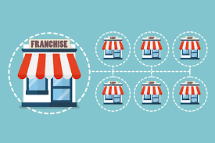
Task: Features of the different types of business ownership
For this qualification, it is really important that you understand the different types of business ownership. In class we will learn about the features of these forms of business ownership and also the advantages and disadvantages of each one. Your task is to research the following forms of business ownership:
Sole trader
Partnership
Franchise
Public limited company
Private limited company
Social Enterprise
You need to identify the features, advantages and disadvantage and for a bonus point can you give real life business examples?

Slide 11
Task: Features of the different types of business ownership
Sole trader Features Advantages Disadvantages | Partnership Features Advantages Disadvantages
Franchise Features Advantages Disadvantages | Public limited company Features Advantages Disadvantages
Private limited company Features Advantages Disadvantages | Social Enterprise Features Advantages Disadvantages

Slide 12

Task: Social Enterprise
Social enterprises are businesses that are changing the world for the better. Like traditional businesses they aim to make a profit but it’s what they do with their profits that sets them apart – reinvesting or donating them to create positive social change. Social enterprises are in our communities and on our high streets – from coffee shops and cinemas, to pubs and leisure centres, banks and bus companies.
https://www.socialenterprise.org.uk/what-is-it-all-about/
Your task is to research a social enterprise (some examples are below)
You need to create a presentation on the following:
What do they sell?
What makes them a social enterprise?
What does the social enterprise do with their profit?
Examples of social enterprises:
The big issue
Jamie Oliver's restaurant fifteen

Slide 13

Task: Business in the news
The Lock down and the Coronavirus has had a negative impact on a lot of businesses and has cause some to go administration.
Your task is to find a newspaper article of a business who is struggling because of the Coronavirus and complete a summary of the article including the following:
The business
The problems they are facing?
The impact on staff?
The impact on customers?
The impact on the businesses future?

