Slide 1

Getting ready for
A level Psychology
Course Outline and Introductory Activities

Slide 2

The following slides provide a useful introduction to a level psychology at park hall.
Please complete the attached booklet as you go through the slides.

Slide 3

Course Outline
The course covers a range of topics – covered in 3 examinations at the end of year 13.
Year 12 | Year 13
Memory | Relationships
Social Influence | Addiction
Attachment | Stress
Psychopathology (the study of abnormal behavior) | Issues and Debates
Approaches | Approaches
Biopsychology | Biopsychology
Research Methods | Research Methods
Paper 1
Paper 2
Paper 3

Slide 4
What Skills Will learn?
Analytical Thinking
Improved Communication
Problem Solving
Planning and Conducting scientific research
Analysing and interpreting data
Critical reasoning Skills
Find out more here using the AQA student guide to A level Psychololgy.

Slide 5
Skills = Assessment Objectives
Unlike at GCSE – there is much more emphasis on application (AO2) and evaluation (AO3) of knowledge.
AO1 | Knowledge and Understanding | Demonstrate your knowledge of Psychology. Be able to describe psychological concepts and theories clearly using appropriate language.
AO2 | Application | Apply your knowledge of psychology to original scenarios and data provided in the exam.
AO3 | Evaluation | Discuss the strengths and weaknesses of theories and research. (For example, using supporting and contradictory evidence). Consider whether theories have any useful ‘real world applications’.

Slide 6
Psychological Approaches
There is no single ‘accepted’ approach towards studying psychology – the science of behaviour.
Instead – it is more useful to think of ‘Psychology’ as an umbrella term which refers to a number of different approaches to studying and understanding human behavior.
For example, each of these approaches have their own way of explaining behaviours such as attraction, addiction and depression.
The main approaches to psychology include.
Biopsychology
Behaviourism
Social Learning Theory
Cognitive Psychology
The Psychodynamic Approach
Humanistic Psychology

Slide 7
Biopsychology
Behaviour is mainly influenced by ... | Our Biology (brain, nervous system, neurons, hormones and genes)
Watch | Know your brain
Abnormal behaviours occur due to ……. | Inheritance of genes that make us vulnerable to mental illness. Brain damage Hormonal / Neurotransmitter in balance
Real World Applications | Medication to combat mental illness Combatting stress

Slide 8
Biopsychology: KEY STUDY
Write a 300 word summary, outlining
1) The Aim of the research
2) The Method Used
3) The Results / Findings
4) Find either
* a strength
* a weakness or
* a real-world application
of that study
Maguire (2000) London Taxi Driver Study

Slide 9
behaviourism
Behaviour is mainly influenced by ... | Learning through punishment and reward.
Watch | How to Train a Brain
Abnormal behaviours occur due to ……. | Abnormal behaviours being rewarded (or not punished.)
Real World Applications | Childcare Adult Training Overcoming Phobias

Slide 10
Behaviourism: KEY STUDY
Write a 300 word summary, outlining
1) The Aim of the research
2) The Method Used
3) The Results / Findings
4) Find either
* a strength
* a weakness or
* a real-world application
of that study
Skinner (1930’s)
‘Skinner Box’ experiments on positive and negative reinforcement

Slide 11
social learning theory
Behaviour is mainly influenced by ... | Our observation and imitation of others.
Watch | The Bobo Beatdown
Abnormal behaviours occur due to ……. | Seeing an imitating the abnormal behavior of others. (Particularly if we see that behaviour being rewarded.)
Real World Applications | Media Consumption (particularly in children) Leadership Advertising

Slide 12
Social learning: KEY STUDY
Write a 300 word summary, outlining
1) The Aim of the research
2) The Method Used
3) The Results / Findings
4) Find either
* a strength
* a weakness or
* a real-world application
of that study
Bandura (1961)
Bobo Doll Experiment

Slide 13
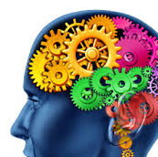
cognitive psychology
Behaviour is mainly influenced by ... | Our own thought processes.
Watch | How we make memories
Abnormal behaviours occur due to ……. | Negative (or irrational) thoughts about ourselves and the world
Real World Applications | Memory Eyewitness Testimony Cognitive Behavioural therapy (CBT)

Slide 14
Cognitive psy: KEY STUDY
Write a 300 word summary, outlining
1) The Aim of the research
2) The Method Used
3) The Results / Findings
4) Find either
* a strength
* a weakness or
* a real-world application
of that study
Loftus (1974)
Car Crash Experiment

Slide 15
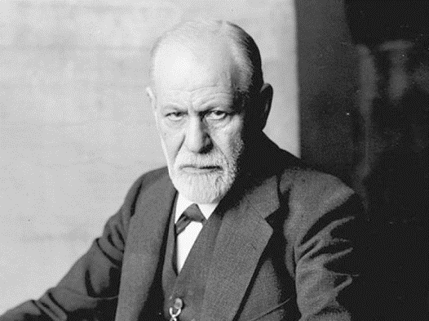
Psychodynamic approach
Behaviour is mainly influenced by ... | Unconscious factors that are largely unknown to us.
Watch | Psychotherapy – Sigmund Freud
Abnormal behaviours occur due to ……. | Negative experiences or trauma experienced in childhood. Negative or shameful memories remain hidden in our ‘unconscious’.
Real World applications | Psychoanalysis (Therapy) Dream analysis Advertising

Slide 16
Psychodynamic: KEY STUDY
Write a 300 word summary, outlining
1) The Aim of the research
2) The Method Used
3) The Results / Findings
4) Find either
* a strength
* a weakness or
* a real-world application
of that study
Freud (1885)
Anna O Case Study

Slide 17
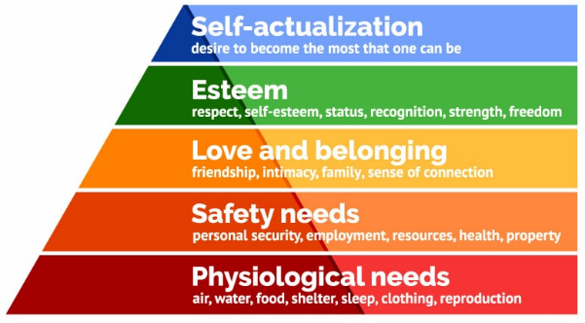
humanistic psychology
Behaviour is mainly influenced by ... | Our own free will. We choose how to behave.
Watch | The Power of Motivation
Abnormal behaviours occur due to ……. | Feelings of low self worth - or conditions arising from basic needs not being met.
Real World applications | Psychoanalysis (Therapy) Dream analysis Advertising

Slide 18
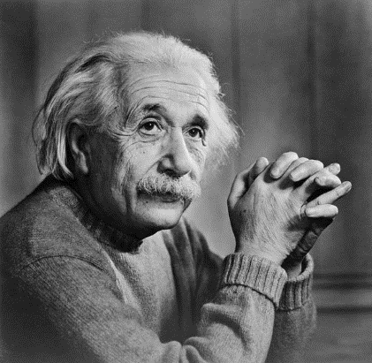
Humanistic psy: KEY STUDY
Albert Einstein was one of the 18 people Maslow studied as an example of someone who had achieved ‘self actualization’.
Write a 300 word summary, outlining
1) The Aim of the research
2) The Method Used
3) The Results / Findings
4) Find either
* a strength
* a weakness or
* a real-world application
of that study
Maslow (1970)
Biographical Analysis of 18 ‘self actualized’ people

Slide 19

Psychology: A Very Short Introduction
Gillian Butler & Freda McManus the lucifer effect: understanding how good people turn evil
Philip zimbardo mindwatching: Why we behave the way we do hans & Michael eysenck mistakes were made but not by me carol tavris the jigsaw man paul britton
Reading List

Slide 20






Slide 21
The mind: explained
Netflix: narrated by emma stone crash course psychology youtube: hank green
Watch List

Slide 22

MIND CHANGERS​
BBC SOUNDS PODCAST: CLAUDIA HAMMOND​
​
(PARTICULARLY EPISODES ON CARL ROGERS, BF SKINNER, ABRAHAM MASLOW, JULIAN ROTTER, ELIZABETH LOFTUS, JOHN WATSON, SOLOMON ASCH, CASE STUDY OF HM, THE HAWTHORNE EFFECT, THE BOBO DOLL, THE STANFORD PRISON EXPERIMENT ​
​
​
ALL IN THE MIND​
BBC SOUNDS PODCAST: CLAUDIA HAMMON
Listen List

Slide 23
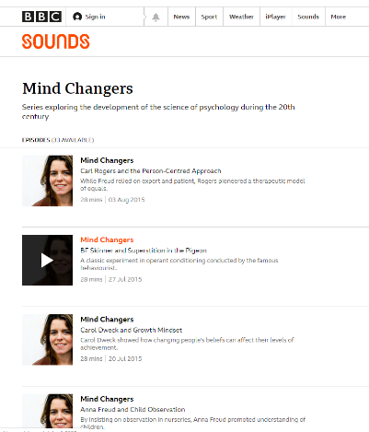
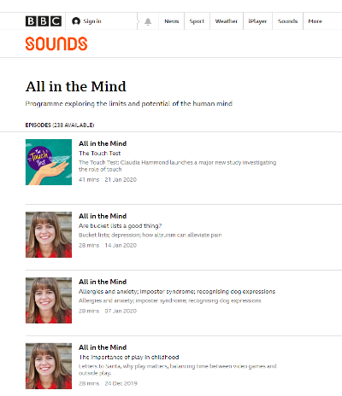
Click to access Mind Changers​
(Very relevant to the A level)
Click to access All in the Mind

Slide 24
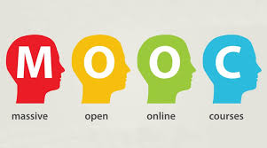
Psychology & Mental Health: Beyond nature and Nurture ​ ​ Introduction to Psychology: The History and Science of Psychology ​ ​ Introduction to Cognitive Psychology: An Experimental Science ​ ​ Young People and Their Mental Health ​ ​ ​ Managing Mental Health and Stress ​ ​ Forensic Psychology: Witness Investigation ​ | University of Liverpool ​ (3 hrs x 6 weeks) ​ ​ Monash University ​ (6 hrs x 2 weeks) ​ ​ University of York ​ (4 hrs x 3 weeks) ​ ​ ​ University of Cambridge ​ (2 hrs x 5 weeks) ​ ​ ​ Coventry University ​ (3 hrs x 2 weeks) ​ ​ Open University​ (3 hrs x 8 weeks)​
What are MOOCs? ​
MOOCs are courses delivered online and are accessible to all for free. ​
MOOCs typically comprise video lessons, readings, assessments, quizzes and discussion forums. ​
Explore for yourself at:​
www.futurelearn.com ​
www.classcentral.com

Slide 25

I HOPE YOU ENJOYED THIS INTRODUCTION TO A LEVEL PSYCHOLOGY​
​
PLEASE COMPLETE THE ASSOCIATED BOOKLET AS A REFLECTION OF YOUR PARTICIPATION.

