Slide 1



Park Hall Academy
Transition Booklet: BTEC Performing Arts 2020-21
Name:__________________

Slide 2
What will I be studying?
For students with their sights set on a career in the performance industry, a BTEC in Performing Arts is a great choice. The practice-based course aims to provide you with the relevant skills and knowledge that employers value, as well as the confidence to progress into a fulfilling, exciting career in a creative industry.
The Pearson BTEC Level 3 National Extended Certificate in Performing Arts is equivalent in size to 1 A level and will allow you to progress on to many university degrees. Please see some examples below:
BA (Hons) in Drama and English if taken alongside, for example, A level in English Literature or Language.
BA (Hons) in Digital Media Design if taken alongside, for example, a Pearson BTEC Level 3 National Diploma in Media Studies
BA (Hons) Drama and History if taken alongside, for example, A level History
Everyone taking this qualification will study four units covering the following content areas:
During unit one, Investigating Practitioners’ Work, you will focus on:
Developing skills that allow you to investigate the work of influential performing arts practitioners. You will identify the contextual factors that influence their work and critically analyse key information, such as creative intentions, performance, production and repertoire in order to develop and communicate independent judgements. To complete the assessment tasks within this unit, you will need to draw on your learning from across your programme. This unit will give you skills in research, critical analysis and extended writing that will support your progress to higher education. As a performing arts practitioner you will need to have a good understanding of the work of influential practitioners to inform your own work and professional practice
Unit 1 will be assessed through a task, which will be set by Pearson. You will need to use your understanding of the contextual factors that influence the practitioners’ work and creative intentions, and your ability to critically analyse work and make connections to the theme through communication of independent judgements. You will research and analyse the work of performing arts practitioners in response to a given brief.
During unit two, Developing Skills and Techniques for Live Performance, you will focus on:
This unit serves as an induction into the performing arts where you will develop the appropriate skills and techniques in one or more of the performance disciplines of acting, dance, musical theatre, physical theatre and variety/popular entertainment. You will participate in regular workshops, classes and exercises where you will acquire, practise and develop the necessary technical, practical and interpretative performance skills to help you succeed when performing live to an audience. You will consider the nature, skills and attributes of the performer’s role in your chosen discipline. You will work with existing performance works, analysing and interpreting the material in order to understand and apply the relevant skills and techniques appropriate to the style. In practical classes you will demonstrate the discipline, focus and commitment the role of the performer requires. Ongoing review and evaluation will allow you to monitor your progress and set targets for the development of your performance skills.
This unit is assessed by series of assignments set at school. You will provide practice assignments to help you prepare for the final assessment. You will need to check that your work first meets all the pass criteria before moving on to merit and then finally distinction criteria.
During unit three, Group Performance Workshop, you will focus on:
Learrnign how to respond to a given stimulus as part of a group, using research, discussion and practical exploration to develop performance material and later present an informal presentation of the work to an invited audience. As a member of a team, you will contribute to the creative development and rehearsal process, shaping and refining the work and applying performance and teamwork skills. You will share responsibility for creative decisions regarding the nature and direction of the intended performance, and your individual contribution will reflect your own skills through the group’s interests and ideas. The workshop performance will be an opportunity to try out the work before an audience to invite discussion and evaluation of its potential. The work may be in a single discipline or combine elements of dance, acting, musical theatre and variety. You will reflect on the development process, considering the success and potential of the work for further development, as well as evaluating your own contribution to the process and the product. To complete the assessment tasks within this unit, you will need to draw on your learning from across your programme.
For assessment, you will be given a stimulus to create performance material. In groups that consist of a minimum of three and a maximum of seven members, you will respond to the stimulus and develop the performance workshop for an invited audience. You will submit a digital process log completed at four milestone stages during the development process, responding to prompts provided by Pearson, and a video recording of the group workshop performance, between 10 and 20 minutes in duration.
During unit 27, Musical Theatre Techniques, you will focus on:
In this unit, you will develop the skills required to be a musical theatre performer by participating in technique classes, rehearsals and final performance. By learning about the key features of musical theatre performance you will develop an understanding of the skills and techniques required to create a successful performance. You will reflect on your progress as you develop skills and techniques in acting, singing and dance, setting targets and reviewing your progress.
This unit is assessed by series of assignments set at school. You will provide practice assignments to help you prepare for the final assessment. You will need to check that your work first meets all the pass criteria before moving on to merit and then finally distinction criteria.

Slide 3
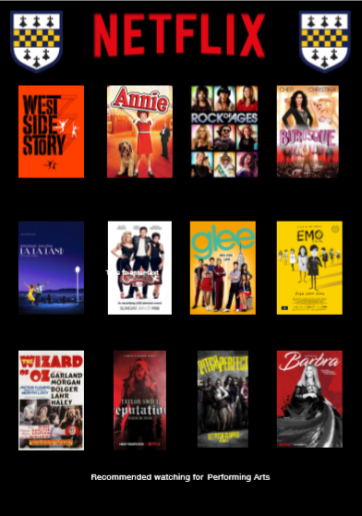

Slide 4
Performing Arts FREE Online Courses
There are a range of different platforms online which allow you to access free online courses. However, I have listed on this document the ones I feel would be most useful to deepen and broaden your Performing Arts beyond the A level specification. However, this list is not exhaustive so please do free to explore the websites and see if there are other courses available which interest you.
Name | Outline | Course Length | Link
An Introduction to Screenwriting | You’ll learn from a mixture of basic theory, script analysis and practical exercises. We will explore key principles as they’re expressed in great films, then immediately apply these concepts. Videos, articles and discussion steps will offer you the opportunity to learn and engage with other learners on key concepts and ideas. | 2 weeks 3 hours a week | https://www.futurelearn.com/courses/screenwriting
Shakespeare: Print and Performance | We will take you on to the stage of the Globe Theatre, to find out about performance practices both in the present day capital and in Early Modern London. We’ll meet practitioners at the Globe and we’ll step into the world of the early modern actor to examine the processes and conditions that were at the heart of the Shakespearean playhouse. | 4 weeks 2 hours a week | https://www.futurelearn.com/courses/shakespeare
Physical Theatre: Meyerhold and Biomechanics | Experience the revolutionary approach to acting by world-renowned Russian director Vsevolod Meyerhold and his technique of biomechanics. You’ll explore key players in Russian actor training, and through expert panel discussions you’ll consider Meyerhold’s contribution and how his work is still relevant today. You’ll learn Meyehold’s techniques and be introduced to one of his études – a short repeatable exercise used by him to develop balance, awareness and expression. | 3 weeks 4 hours a week | https://www.classcentral.com/course/physical-theatre-1571

Slide 5
Performing Arts FREE Online Courses
There are a range of different platforms online which allow you to access free online courses. However, I have listed on this document the ones I feel would be most useful to deepen and broaden your Performing Arts beyond the A level specification. However, this list is not exhaustive so please do free to explore the websites and see if there are other courses available which interest you.
Name | Outline | Course Length | Link
Othello: In Performance | On this free online course, designed with A-level learners in mind, you will discover how the performances and interpretations of Othello have evolved from its first performance in 1604 to the present day. You will find out what influenced performance choices then and now, and how specific themes within the text have been addressed at different moments in history. Ultimately, you will analyse the Royal Shakespeare Company’s most recent production of Othello, informed by your learning over the four weeks and exploring three specific scenes. | 4 weeks 3 hours a week | https://www.classcentral.com/course/othello-5193
Explore Filmmaking: from Script to Screen | This film production course from the NFTS and the BFI Film Academy will deepen your understanding of the filmmaking process and show you how to take it further – whether making your own short films, thinking about a career, or simply a deeper appreciation of the films you watch. This course is for anyone interesting in filmmaking. Whether you’re a budding filmmaker or a film fan who wants to understand more about what happens behind-the-scenes, this course from the internationally acclaimed National Film and Television School will have something for you. | 6 weeks 3 hours a week | https://www.classcentral.com/course/explore-filmmaking-3001
Much Ado about Nothing: in Performance | Shakespeare’s much loved play, Much Ado about Nothing, is read and studied all over the world. But it was written to be staged, and can only be fully appreciated and understood through performance. In this free online course, the Royal Shakespeare Company (RSC), the University of Birmingham’s Shakespeare Institute and the Shakespeare Birthplace Trust will welcome you to Stratford-upon-Avon - the home of William Shakespeare and the Royal Shakespeare Theatre. | 4 weeks long 3 hours a week | https://www.classcentral.com/course/much-ado-about-nothing-3005

Slide 6
Performing Arts FREE Online Courses
There are a range of different platforms online which allow you to access free online courses. However, I have listed on this document the ones I feel would be most useful to deepen and broaden your Performing Arts knowledge beyond the A level specification. However, this list is not exhaustive so please do free to explore the websites and see if there are other courses available which interest you.
Name of Course | Outline | Number of Hours/Weeks | Link
Physical Theatre: Exploring the Slap | This course introduces you to world-renowned Russian director Meyerhold’s technique of biomechanics. It invites you to study and experience first-hand his revolutionary biomechanical étude, ‘The Slap’. Through a mixture of video, animation, discussion forums and practical exercises you will begin to understand Meyerhold’s Russian actor training technique – a two-minute repeatable exercise used to develop balance, awareness and expression. You will be invited to explore your own response to this unique approach to training and will share these responses with your fellow learners. |  | https://www.futurelearn.com/courses/physical-theatre-exploring-the-slap

Slide 7



The Origins of Musical Theatre
Musicals are often linked with America but Musical Theatre actually has its roots in the early operettas of the UK – Gilbert & Sullivan.
TASK: Research and provide details on the following areas of Musical Theatre;
OPERETTAS
OPERA
MUSICALS
For each heading you must include information such as:
Key dates
Names of musicals
Main features and characteristics
Images
Examples of repertoire (shows)
https://www.bbc.co.uk/bitesize/guides/z2hr7ty/revision/1

Slide 8
Musical Theatre Genres
Find some initial research for each genre listed. Evaluate these genres; what are the key features of these genres. List some musicals that match the genre.
Operetta
Musical revues
Book musicals
Rock musicals
Jukebox musicals
Concept musicals
Comic musicals / Musical Comedy
Chamber musicals
https://www.bbc.co.uk/bitesize/guides/z27fyrd/revision/1

Slide 9
Types of songs
Research the following types of Musical Theatre song/music;
Describe (p) , explain (m) and analyse (d) each one.
OVERTURE
SOLO-CHARACTER SONG
DUET
ACTION SONG
CHORUS/PRODUCTION NUMBER
SOLO
BALLAD
MUSICAL SCENES
SCENE CHANGE MUSIC
REPRISE
DANCE INTERLUDE
SHOWSTOPPER
FINALE

Slide 10
Learning Log
Record here any additional reading/viewing you are undertaking in order to show what you have been completing in order to prepare you for the course. Use the reading list on the previous slides you have been given for guidance on what you could you watch/read/
Date | Title | Summary of content | My thoughts

Slide 11

Task: Research and define the following words which are central to Unit 2 .
Term | Definition
Devise
Interpretation
Collaborate
Characterisation
Frantic Assembly
Stanislavski
Monologue
Dialogue
States of tension
Appreciation

Slide 12

Task: Research a list of Performing Arts related jobs/ terms for each letter of the alphabet
A
B
C
D
E
F
G
H
I
J
K
L
M
N
O
P
Q
R
S
T
U
V
W
X
Y
Z

Slide 13

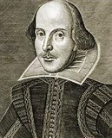
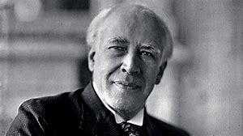
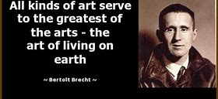
The History of Theatre
Task: You need to create an A4 Theatre history timeline. On your timeline you should include reference people, styles and events
To make a high quality timeline, you will need to do some additional research into what each of the events actually refers to – and why it might have been important to the development of Theatre.

Slide 14
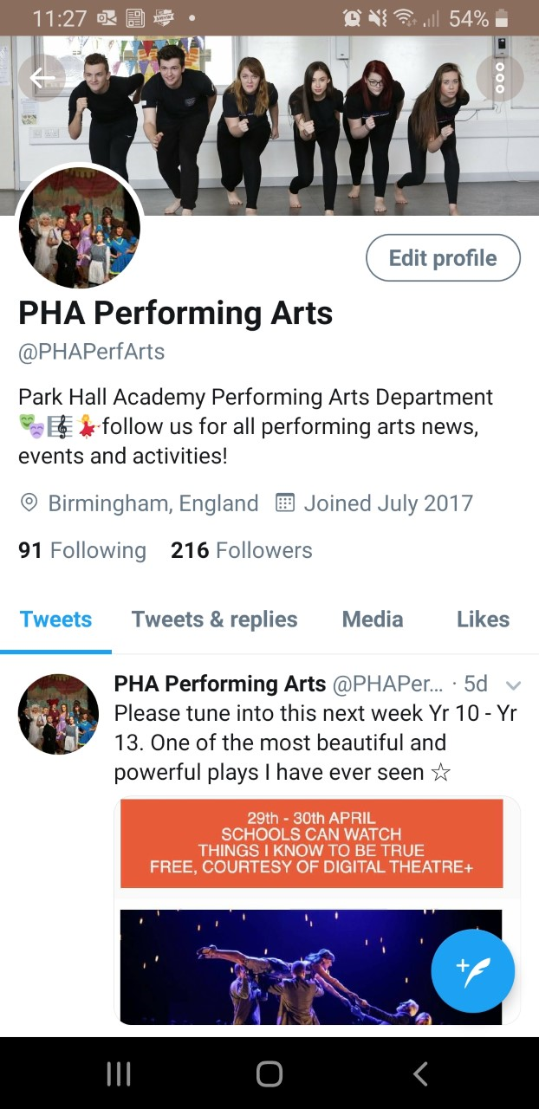

Performing Arts Today:
Task. Twitter is used by all those related to Performing Arts, I would advise that you create yourselves Twitter accounts as soon as possible and follow the below users for information and news:
@PHAPerfArts (Park Hall Performing Arts Department)
@franticassembly (Frantic Assembly Company)
@NationalTheatre (National Theatre)
@Birmingham Rep (The Birmingham REP theatre)
Your second task is to keep an eye on these Twitter accounts (as well as wider sources – watch lots of films and take notes of acting techniques and how the actor has approached the character.
Watch lots on You Tube and research as much as you can.

Slide 15

If you have any further questions while you are enjoying Working From Home and your Summer holiday, my email address can be found below ☺:
Mrs Cullum-Kenyon
Ecullum-kenyon@parkhall.org

