Slide 1

Introduction to Criminology

Slide 2

The aim of Unit 1: Changing Awareness of Crime
This unit is a controlled assessment / coursework unit
The aim of your coursework is to ‘plan campaigns for change relating to crime’
In this unit you will:
    Analyse different types of crime
    Explain why certain crimes go unreported
    Explain the consequences of unreported crime
    Describe the links between crime and the media and the impact this has
    Look at crime statistics
    Compare and evaluate campaigns for change
    Complete your controlled assessment

Slide 3
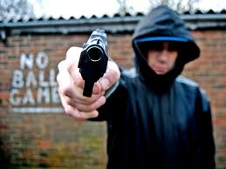
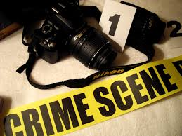
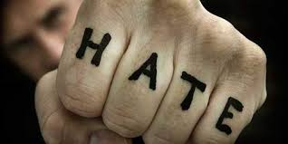
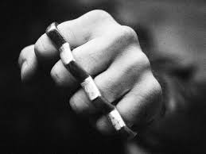
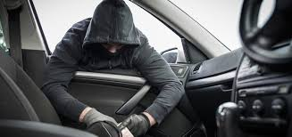
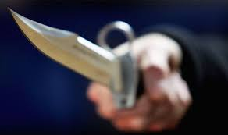
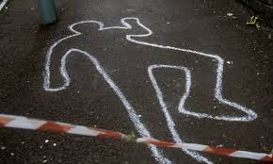
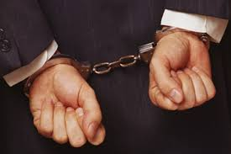
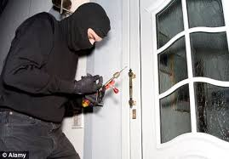
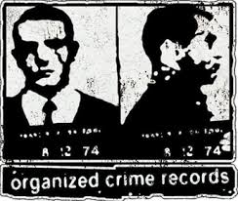
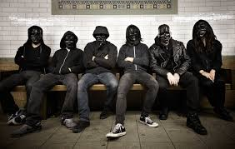
AC 1.1:Types of crime

Slide 4
Learning objectives:
Bronze | To explain a variety of types of crime
Silver | To analyse who the perpetrators and victims are of a variety of crimes
Gold | To evaluate how widespread a variety of crimes are in the UK and the world

Slide 5
Type of crime 1: White Collar Crime
Definition: ‘a nonviolent crime committed for financial gain’
There are three main types of white collar crime:
    Organised
    Corporate
    Professional
Research task:
Research types and variety of white collar crime.
Consider the case of Bernard Madoff and Ponzi Schemes
http://news.bbc.co.uk/1/hi/business/8124838.stm
15 minutes

Slide 6
Examples of white-collar crime
Bribery and corruption in government and businesses
Fiddling expenses
Professional misconduct
Fraud
Embezzlement
Lord Conrad Black (millionaire former owner of the Daily and Sunday Telegraph) was convicted and jailed for 6.5 years in the US for misusing his position to defraud shareholders of millions of dollars
One GP made £700,000 over five years writing fake prescriptions

Slide 7
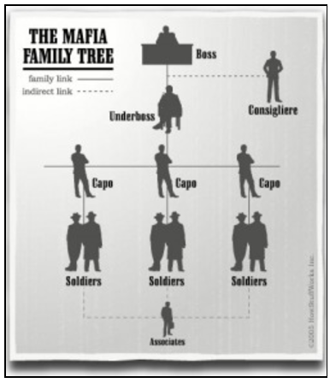
Organised crime
Definition: ‘criminal activities that are planned and controlled by powerful groups and carried out on a large scale’
The Mafia (Italy or Sicily, USA)
Who are they?
Originally from Italy or Sicily and commonly found in the USA, the Mafia are huge crime gangs, who are usually related by family. They are defined by having a strict hierarchy, with the ‘boss’ at the top who heads up the ‘legal’ businesses and the ‘capos’ and ‘soldiers’ who commit the crimes. Each family has separate business dealings and they tend to stay out of each other’s way
What crimes do they commit?
Extortion (threatening people so they give them money), protection rackets, drug dealing and smuggling, prostitution, illegal gambling, gang war, assassination, murder, anything that will make them money

Slide 8
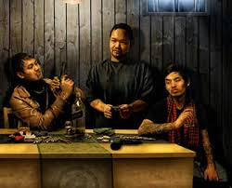
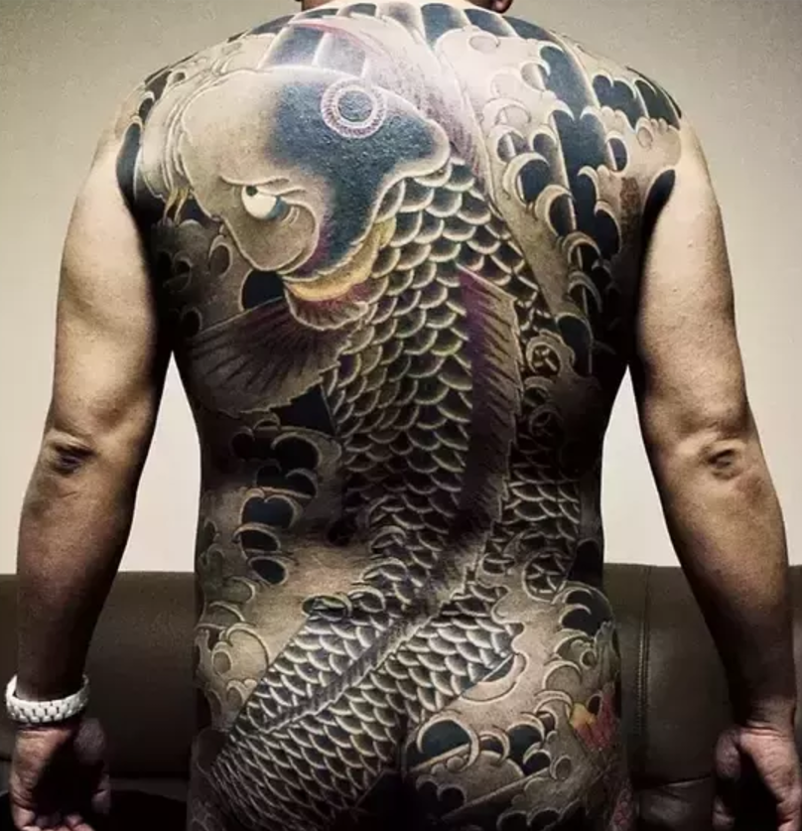
The Triads (China)
Who are they?
Triads are the most well-known organized crime group in China, Hong Kong and Macao. The number of people involved in organized crime in general has risen from around 100,000 in 1986 to around 1.5 million in 2000. New members are often recruited among the 120-million-strong "floating population" of migrant workers.
What crimes do they commit?
People trafficking, drug smuggling, illegal gambling and extortion; murder, rape, robbery, kidnapping, assault
The Yakuza (Japan)
Who are they?
The Yakuza is the world’s largest organised crime group and has approximately 60,000-members. It is made up of 22 families, called boryokudan (“violence group”). These boryokudan are often made up of smaller affiliated gangs. Out of the 22 boryokudan, there are three main families. The Yakuza identify each other through tattoos.
What crimes do they commit?
They operate a huge portion of Japan's nightclubs, love hotels, gambling pits, casinos and prostitution services. Heroin and opium dealing, blackmail, child pornography, murder, sex slavery and human trafficking

Slide 9
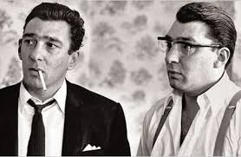
What about organised crime in the UK?
Who knows who these people are?
Arguably, the Kray twins were the original English organised crime gangsters
They set up their gang across east London and ran many illegal businesses over the years
Watch the following documentary and make notes, ready to make a case-study sheet on the Krays
https://www.youtube.com/watch?v=crnROARFX5k

Slide 10
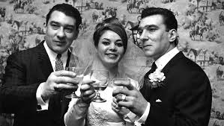
The Krays; a case study
Create a case study explaining the life of the Krays. You can choose which way to present this:
As a timeline
As a ‘wanted’ poster
As a 1 sheet autobiography
As a criminal history sheet
Any other way you like
Include a minimum of:
Their background and upbringing
The time they were working in
The most famous crimes they committed
What eventually happened to them
Any other information you find interesting
EXTENSION:
Does mental illness contribute to criminality?

Slide 11
Organised crime in the UK today
http://www.independent.co.uk/news/caution-you-are-about-to-enter-gangland-britain-1597228.html
Read the article and answer the following questions:
Why is organised crime in the UK arguably more ‘complex than ever before’ according to Parliament?
How is the British banking system used by organised gangs?
How is organised crime structured in the UK?
In 1995 (when the article was written), how many criminals were on the NCIS’ list?
EXTENSION QUESTION: How many people did the NCA (National Crime Agency- replaced NCIS) monitor in 2014? (use Wikipedia)
How much organised crime in the UK involves drug supplying?
What types of illegal activities are growing?
Who were one of the most powerful family gangs in recent years? Who are they/where are they from/ what did they do?
How are door-men involved in organised crime in the north-east of England?
Which group are the only ones to be able to stop other gangs encroaching on their territory? Why is this?
What are the two biggest ‘ethnic community’ organised gangs that have been established since the 70s?
What is ‘tea money’?
How many Triad groups work in the UK and how do they work?
Which group monopolises the supply of crack cocaine?
How have former Soviet Union gangs broken into the UK?
Summarise who all of the different gangs that operate in the UK are- 1 sentence for each

Slide 12
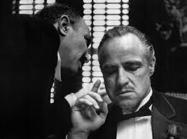
‘Will we ever know the full extent of organised crime in the UK?’
Explain your opinion in 50-60 words

Slide 13
Corporate crime
Corporate crime refers to crimes committed either by a corporation (business), or by individuals acting on behalf of a corporation or other businesses
Examples of corporate crime:
  Paperwork and non-compliance- not complying with health and safety regulations
  Environmental (green) crimes- damaging the environment, either deliberately or through negligence
  Manufacturing offences- producing unsafe products/counterfeit goods
  Labour law violations- not complying with worker health and safety policies
  Unfair trade practices- false advertising; price fixing; illegally obtaining information on rival businesses
  Financial offences- tax evasion; concealment of losses or debts

Slide 14
Examples of corporate crime:
The Thalidomide case study
Thaliomide was developed by the drug company Chemie Grunenthal, but it was not adequately tested
It was give to pregnant women in the 1950s to combat morning sickness
However it resulted in 10,000 infants being born with deformed limbs
There were delays in withdrawing the drug from the market
No one was ever prosecuted
1984: The Bhopal disaster
The Bhopal disaster was the worst industrial tragedy in history, with an estimated 25,000 people killed as a result
A chemical factory started leaking a deadly gas due to a faulty valve
The factory was located next to an intensely overcrowded slum, and half a million people were exposed to the gas
The gas caused people’s lungs to fill up with fluid, with most dying from cardiac arrest or respiratory failure
https://www.youtube.com/watch?v=lUuKocuJtBM

Slide 15
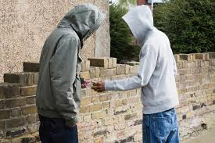
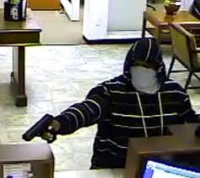
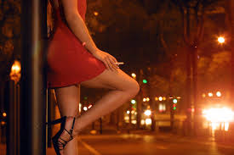
Professional crime
Definition: ‘people for whom crime is their permanent occupation and primary source of income.’
Examples:
    Major drug dealers
    Bank robbers
    Assassins
    Human traffickers
    Prostitution

Slide 16
From this we can see that the people who are committing these white-collar crime are powerful people like politicians and business executives.
These crimes in recent times are becoming more raised to our attention and have the interest of the public. Before a lot of what was going on was mostly being ignored.
Cases including environmental pollution, health and safety violations, fraud, consumer affairs, money laundering and food regulation.
The reasons behind why these crimes go unnoticed can be that the social and political interest is lower. Media attention paid to white collar crime is different. The space devoted to it is far less, is far less prominent, it can be only in specialist press issues or just business sections of the mainstream press.
Also can be really difficult to research as much of the business activity is private or hidden. Many criminologists have avoided writing as the knowledge on this area is limited. Many crimes go unreported and are not included in crime statistics.

Slide 17
Type of crime 2: Moral and immoral crime
(moral turpitude crimes)
Immoral crime, definition: ‘a phrase used in criminal law to describe actions that go against the morals of society. Crimes involving moral turpitude have an inherent quality of vileness, depravity or evil against individuals or society in general.’
Examples:
    Rape
    Paedophilia
    Prostitution
    Slavery
    Incest
    Bestiality
    Torture

Slide 18
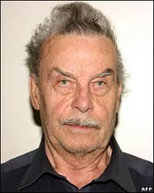
Example of an immoral crime:
In 1984, Fritzl lured his 18-year-old daughter Elisabeth into his cellar where he drugged her and raped her repeatedly.
After telling his own wife that Elisabeth had ran away and joined a cult, Fritzl managed to keep his daughter prisoner in the soundproof basement for 24 years.
Josef fathered seven children with his own child in the small cellar where he had installed cramped living quarters including a kitchen and bathroom.
While one of the children died shortly after birth, and was incinerated by Fritzl, three of the other kids were brought upstairs to live with him and his wife Rosemarie .
Fritzl told his spouse that the children belonged to Elisabeth and had been left on their doorstep as she was unable to care for them.
The three remaining children were kept in the windowless cellar –aged five to 19 when released – and would first see sunlight in 2008.
Fritzl’s crimes were uncovered when the oldest cellar child, a 19-year-old girl, became seriously ill.
Elisabeth begged her father to take the girl to hospital and later that day doctors quickly alerted police to Fritzl’s home after questioning the teenager who had never been in the outside world before.
In March 2009, Fritzl was jailed for life after pleading guilty to murder by negligence, over the death of the baby he cremated.
The other charges included enslavement, incest, rape, coercion and false imprisonment.
Josef
Fritzl

Slide 19
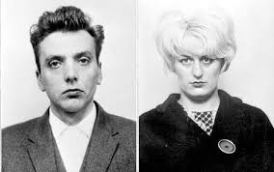
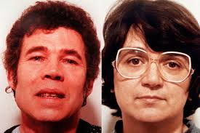
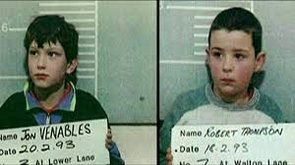
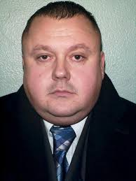
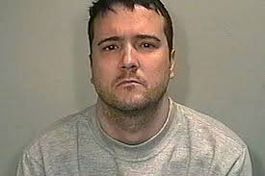
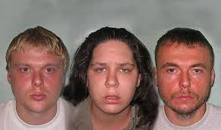
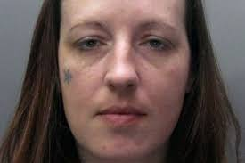
Can you think of any other immoral crimes?

Slide 20
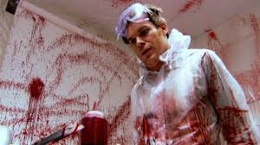
Fun fact: how many active serial killers are there in the UK at any one time?
Research indicates 2 at any one time
How about in the USA?
30-50

Slide 21
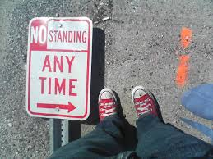
Moral crimes- crime as a protest
Some crimes are committed because people have moral objections to laws. These cases are often on controversial or moral topics.
Which laws would you change if you could?
Is it acceptable to break the law if that law is bad or unjust? Give reasons for your answer

Slide 22
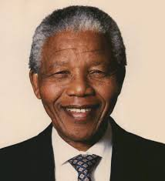
Who is this man?
Nelson Mandela
Did you know Mandela was a criminal in South Africa?
Conduct research to find out the following information:
What was happening in South Africa during Nelson Mandela’s early years? (Apartheid) Explain the reality of living under this regime
What was Mandela’s early life like?
What happened when he became an adult?
What kind of crimes was Mandela put in prison for?
How long did he spend in prison?
What happened to cause Mandela to be released from prison?
What happened after he was released?
Do you consider Mandela to still be a criminal? Why?
EXTENSION:
Find out about other people that have committed crimes because they have a moral objection to laws

Slide 23
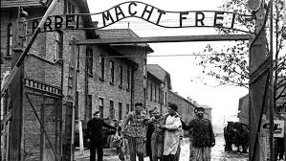
Type of crime 3: State crime
State = a country or its government
Definition: activity or failures to act that break the state's own criminal law or public international law
Examples of state crimes:
The torture and illegal treatment and punishment of citizens
Corruption
Assassination and ‘targeted killing’
War crimes
Genocide
State-sponsored terrorism

Slide 24
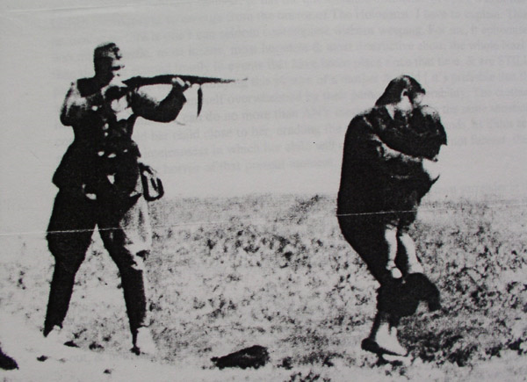
The Holocaust, 1933-45
https://www.youtube.com/watch?v=1Bx86O_E1fk
Nazis kill 5-6 million Jews

Slide 25
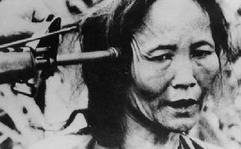
My Lai Massacre, Vietnam 1968
https://www.youtube.com/watch?v=rIvKxT8r8Rc
500 villagers killed by US troops

Slide 26
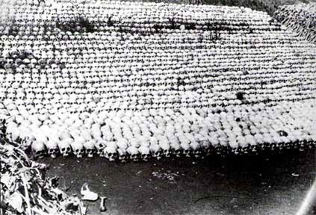
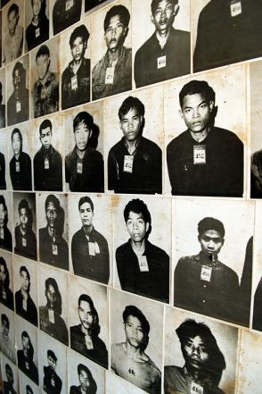
Khmer Rouge, Cambodia, 1975-9
https://www.youtube.com/watch?v=1-SI8RF6wDE&t=89s
Khmer Rouge kill 1-2 million people

Slide 27
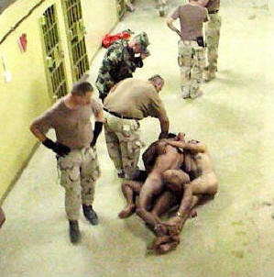
Abu Ghraib prison abuses, 2004
https://www.youtube.com/watch?v=qDkYQD2ImFM
American soldiers torture Iraqi prisoners

Slide 28
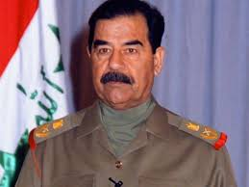
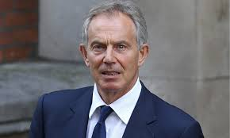
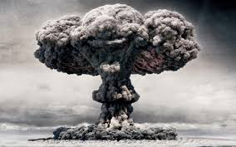
Is state crime obvious?
The cases you have just looked at are obvious examples of state crimes that everyone would find abominable.
Sometimes the situation is not clear-cut. Saddam Hussein murdered people in his country, but when the USA and UK invaded Iraq in 2003, this was also an illegal act.
There were huge protests, and many people believe Tony Blair (PM at the time) to be a war criminal.

Slide 29
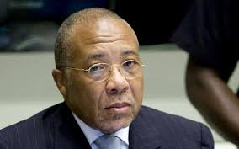
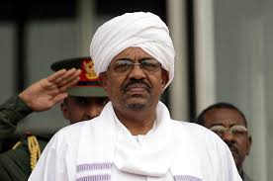
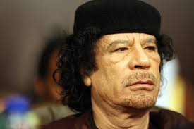
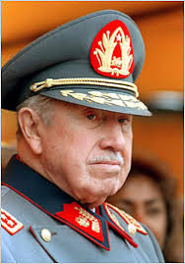
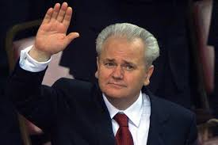
Modern leaders accused of state/war crimes
Charles Taylor
President of Liberia
Convicted of supporting brutal rebels in Sierra Leone in exchange for blood diamonds
Omar Al-Bashir
President of Sudan
Accused of genocide during Darfur conflict, where 300,000 people died
Colonel Muammar Gaddafi
Head of Libya
His regime was accused of murdering prisoners of war and civilians, torture and murder of soldiers, looting
Slobodan Milosevic
President of Serbia
Murder, crimes against humanity
General Augusto Pinochet
President of Chile
Torture and murder

Slide 30

State crime: Amnesty International
Look at the website of Amnesty International.
Make a list of the tactics used by Amnesty International to raise awareness of state crimes against the people.
http://www.amnesty.org.uk/

Slide 31
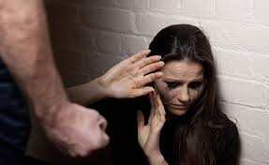
Type of crime 4: Individual crime
Examples of individual crime:
Domestic abuse
Hate crime
Honour crime (with Mrs Long)
Activities; Domestic abuse and rape:
Summarise the information on domestic abuse and rape on pages 884-889. Include:
  What it is
  The extent of it
  The victims
  The perpetrators
  How the police deal with it
  Policy changes
Analyse the information on the two graphs on page 885- what do you notice? General trends?
Research famous cases of domestic abuse and create a case study

Slide 32
Hate crime
Since the public vote on BREXIT there has been a marked increase in this type of crime. Using the sources below and any others you feel are appropriate answer the questions below:
http://www.independent.co.uk/news/uk/crime/brexit-hate-crime-racism-stats-spike-police-england-wales-eu-referendum-a7126706.html
https://www.victimsupport.org.uk/crime-info/types-crime/hate-crime
http://www.stophateuk.org/
http://www.lgbthatecrime.org.uk/
What is hate crime?
Who are the potential victims?
Find two examples of real victims of hate crime and write a summary of each case
Find 2 examples of support groups who help victims of hate crime and outline their aims and objectives
Watch the following documentary on you tube (bbc3 the ugly face of disability – hatecrime)
https://www.youtube.com/watch?v=B03jduD9N5o&safe=active

Slide 33
Wider Reading and useful resources
Keep up to date with the news ! This will help with including examples from a wider context and show higher order thinking.
Keep an eye out for interesting true crime documentaries like Tiger King, The Mysterious Murder of Nipsey Hustle, The Keepers.
https://player.fm/podcasts/Criminology - This is a list of Criminology podcasts.
https://www.youtube.com/channel/UCY8HnjAb_RYmQNGJPn0bPwg - A useful YouTube channel that explains key concepts in Criminology.

