Slide 1



Park Hall Academy
Transition Booklet: BTEC Applied Psychology 2020-21
Name:__________________

Slide 2
What will I be studying?
Psychology is the study of the relationship between behaviour, performance and mental processes. Applied psychology is the application of this knowledge to the real world. This will help you to understand events that occur, treat mental health issues, aggression, buying behaviour and how to treat criminals. There is a wide range of possible employment opportunities following further study at degree level.
The Pearson BTEC Level 3 National Extended Certificate in Applied Psychology is equivalent in size to 1 A level and will allow you to progress on to many university degrees. Please see some examples below:
BSc in Education and Child Psychology if taken alongside, for example, a Pearson BTEC Level 3 Extended Certificate in Health and Social Care and an A level in Biology
BSc (Hons) in Sport Psychology if taken alongside, for example, a Pearson BTEC Level 3 National Diploma in Sport and Exercise Science
BSc in Forensic and Criminal Psychology if taken alongside, for example, a Pearson BTEC Level 3 National Diploma in Forensic and Criminal Investigation.
Everyone taking this qualification will study four units covering the following content areas:
During unit one, Application of Psychological Approaches, you will focus on:
You will develop an understanding of how psychological research and concepts can explain gender, aggression and consumer behaviour:
Social psychology explains how human behaviour occurs in a social context and how people, society and culture can affect behaviour. Cognitive psychology focuses on human information processing and how it can influence, and be influenced by, perception and memory. The learning approach in psychology explains how behaviour is learned from the world around us – through association, the consequent rewards and punishments or through the imitation of role models. The biological approach to psychology takes the opposite view to the learning approach and explains how internal biological processes, such as genetic inheritance, brain structure and chemistry, can affect human behaviour and how these processes can be explained by evolution
This unit is assessed by an examination set and marked by Pearson. The examination will last for 1 hour and 30 minutes. The number of marks for the paper is 72. The paper will consist of a variety of question types, including: extended open-response questions relating to psychological approaches to understanding and explaining human behaviour; scenario- based questions relating to vocational contexts.
During unit two, Conducting Psychological Research, you will focus on:
In this unit, you will learn about the importance of research in psychological inquiry and about the types of research that take place. You will gain an understanding of the research process and the key methods used extensively by researchers to test theories and provide information about the ways in which people think and behave. You learn how to plan a pilot study exploring a current psychological topic, using qualitative and quantitative methods, and taking account of issues, such as ethics, that researchers need to consider when conducting research on human individuals. You will conduct your planned pilot study, selecting and applying knowledge gained in this unit to a chosen area, drawing on key psychological approaches. You will gather and analyse your research findings in order to present them to an audience. Finally, you will reflect on your own learning of the research process as well as drawing on feedback from others and consider implications on practice and provision and your own future professional development.
This unit is assessed by series of assignments set at school. You will provide practice assignments to help you prepare for the final assessment. You will need to check that your work first meets all the pass criteria before moving on to merit and then finally distinction criteria.
During unit three, Health Psychology, you will focus on:
How is stress linked to illness? Why do people become addicted to behaviours or substances? Which factors influence whether people engage in healthy or unhealthy behaviours? These are the questions addressed by health psychologists, who are interested in how psychological and physiological factors affect health and ill health. Health psychology explores the motivation behind healthy and unhealthy behaviours, and the factors that might persuade individuals to finally change a behaviour or to follow the advice given by medical professionals.
This unit is assessed by an examination set and marked by Pearson. The examination will last for 1 hour and 30 minutes. The number of marks for the paper is 72. The paper will consist of a variety of question types, including: extended open-response questions relating to psychological approaches to understanding and explaining human behaviour; scenario- based questions relating to vocational contexts.
During unit 4, Criminal and Forensic Psychology, you will focus on:
Criminal and forensic psychology is a specialist branch of psychology that uses psychological theories to explain criminal behaviour, and examines the research generated by these theories.
In this unit, you will explore psychological approaches to criminal behaviour and learn how offender profiles are created using different techniques. You will examine different psychological methods for modifying and punishing criminal behaviour, and investigate their effectiveness. This will include their impact on both the rate of reoffending and on the individual and society.
This unit is assessed by series of assignments set at school. You will provide practice assignments to help you prepare for the final assessment. You will need to check that your work first meets all the pass criteria before moving on to merit and then finally distinction criteria.

Slide 3




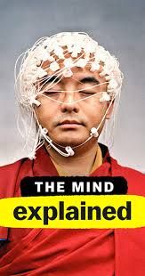
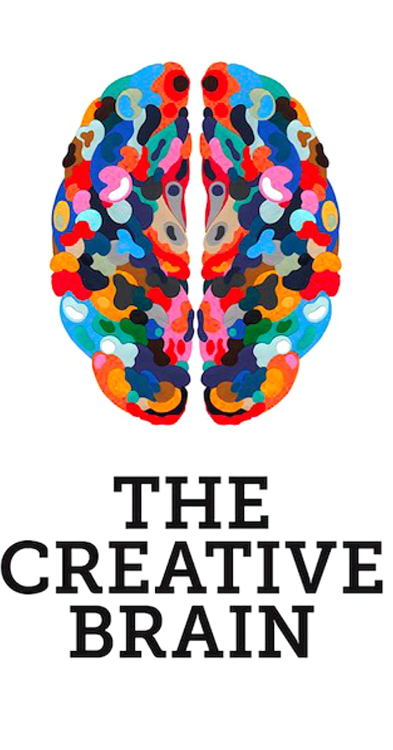







Babies
I am a Killer
Mindhunter
The Mind Explained
The Creative Brain
Inside the Criminal Mind
Heal
100 Humans
Sex Explained
Brain on Fire
Black Mirror
Pandemic: How to prevent an outbreak
Recommended Watching for Applied Psychology

Slide 4

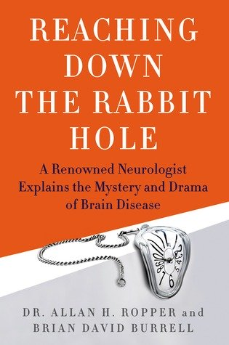







The Happiness Hypothesis: Johnathan Haidt
Reaching Down the Rabbit Hole: David Burrell
Elephants on Acid: Alex Boese
Mistakes were made (But not by me): Carol Travis
The Private Life of the Brain: Susan Greenfield
The Little Book of Psychology: Emily Ralls
The Lucifer Effect: Philip Zimbardo
The Psychopath Test: Jon Ronson
Recommended Reading for Applied Psychology

Slide 5
Psychology FREE Online Courses
There are a range of different platforms online which allow you to access free online courses. However, I have listed on this document the ones I feel would be most useful to deepen and broaden your Psychological knowledge beyond the A level specification. However, this list is not exhaustive so please do free to explore the websites and see if there are other courses available which interest you.
Name | Outline | Course Length | Link
Introduction to Child Psychology | Considers questions such 'What influences children's development?' and 'How do psychologists study the physical and cognitive changes that occur during childhood?' | 8 hours | https://www.open.edu/openlearn/education-development/childhood-youth/introduction-child-psychology/content-section-0?active-tab=content-tab
Social Psychology and Politics | Explores the role of identity, personality and culture for political action. The course introduces a critical perspective considering how psychologists themselves can be activists and interrogating the norms of ‘good citizenship’ in Western societies. | 8 hours | https://www.open.edu/openlearn/health-sports-psychology/social-psychology-and-politics/content-section-0?active-tab=description-tab
Challenging Ideas in Mental Health | Considers the dilemmas of diverse perspectives in the field of mental health. Explores the importance of service users/'survivors' experiences | 18 hours | https://www.open.edu/openlearn/health-sports-psychology/health/challenging-ideas-mental-health/content-section-0?active-tab=description-tab
Exploring Sport Coaching and Psychology | Explore the influence of coaching and psychology through the lens of sports people and teams who have been successful. You will focus on coaching practices used with young people and adults, including research and advice of leaders in their fields. | 24 hours | https://www.open.edu/openlearn/health-sports-psychology/exploring-sport-coaching-and-psychology/content-section-overview?active-tab=description-tab

Slide 6
Psychology FREE Online Courses
There are a range of different platforms online which allow you to access free online courses. However, I have listed on this document the ones I feel would be most useful to deepen and broaden your Psychological knowledge beyond the A level specification. However, this list is not exhaustive so please do free to explore the websites and see if there are other courses available which interest you.
Name of Course | Outline | Number of Hours/Weeks | Start Date | Link
Forensic Psychology: Witness Investigation | Discover how forensic psychology helps obtain evidence from eyewitnesses in police investigations and prevents cases of injustice | 3 hours per week for 8 weeks | Monday 20th April | https://www.futurelearn.com/courses/forensic-psychology
Psychology and Mental Health: Beyond Nature and Nurture | Explore some of the current challenges and debates in the area of diagnosis and treatment. You will gain new perspectives on the “nature vs nurture” debate, and understand how we are affected by life experiences. | 3 hours per week for 6 weeks | Available now | https://www.futurelearn.com/courses/mental-health-and-well-being
Introduction to Cognitive Psychology: Learn how to conduct, analyse and understand cognitive psychology experiments | Consider the psychology of thinking and reasoning. You will learn how to run an experiment, how to collect data, and understand the science behind memory and behaviour through experiments. | 4 hours per week for 3 weeks | 27th April | https://www.futurelearn.com/courses/an-introduction-to-cognitive-psychology-as-an-experimental-science

Slide 7
Psychology FREE Online Courses
There are a range of different platforms online which allow you to access free online courses. However, I have listed on this document the ones I feel would be most useful to deepen and broaden your Psychological knowledge beyond the A level specification. However, this list is not exhaustive so please do free to explore the websites and see if there are other courses available which interest you.
Name | Outline | Course length | Start date | Link
Fundamental Neuroscience for Neuroimaging | Introduces the basic principles of neuroimaging methods as applied to human subject’s research and introduce the neuroscience concepts and terminology necessary for a basic understanding of neuroimaging applications | 8 hours | Started 15th April – can join now | https://www.coursera.org/learn/neuroscience-neuroimaging#about
Sleep: Neurobiology, Medicine and Society | Considers the neurobiological basis of sleep control and how sleep deprivation, jet lag, and substances such as alcohol, caffeine and nicotine alter sleep and wakefulness. | 16 hours | Available now | https://www.coursera.org/learn/sleep

Slide 8



Psychology in the Media
Task: It is important to raise public awareness about issues which are prevailing in society relating to psychology. One way in which public awareness is raised about psychology in general and issues that exist within the health care sector is through the media.
Your task is to pick…
➢ x2 Films
➢ x1 Book
➢ x2 Documentaries
You will then be asked to write an essay with the following title: ‘Discuss the portrayal of psychology within the media’
You must watch/read the some of the examples on the previous slides you have picked and create notes to help with your essay. Consider the following:
• What issues, if any, are being raised in the stimulus?
• How does the stimulus present psychology?
Is the stimulus informative/helpful and why?
• Are there any quotes/scenes etc that stand out to you and why?
• How effective is the stimulus in raising public awareness about psychological Issues?
This list is NOT exhaustive there may be other questions/ideas you wish to consider as you watch or read.

Slide 9
Learning Log
Record here any additional reading/viewing you are undertaking in order to show what you have been completing in order to prepare you for the course. Use the reading list on the previous slides you have been given for guidance on what you could you watch/read/
Date | Title | Summary of content | My thoughts

Slide 10
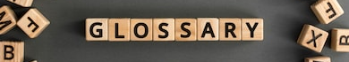
Task: Research and define the following words which are central to the Approaches in Psychology Unit. Then, draw a symbol to summarise the term and help you remember it.
Term | Definition | Symbol
Nature
Nurture
Evolution
Schema
Operant Conditioning
Classical Conditioning
Cognitive Bias
Conformity
Vicarious Reinforcement
Hostile Attribution Bias

Slide 11
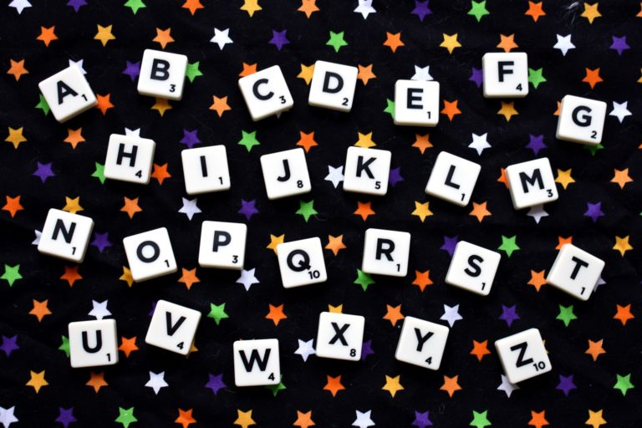
Task: Research a list of Psychology related jobs/ terms for each letter of the alphabet
A
B
C
D
E
F
G
H
I
J
K
L
M
N
O
P
Q
R
S
T
U
V
W
X
Y
Z

Slide 12
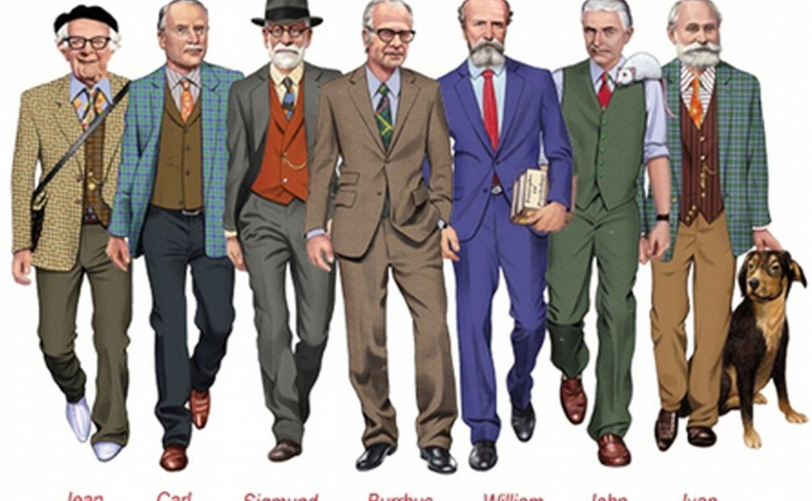
The History of Psychology
Task: You need to create an A4 Psychological History timeline. On your timeline you should include a number of features such as the ones below (but not necessarily ONLY these).
To make a high quality timeline, you will need to do some additional research into what each of the events actually refers to – and why it might have been important to the development of Psychology.
The Curious Case of Phineas Gage, Wilhelm Wundt’s Psychology Lab, foundation of the American Psychological Association, Sigmund Freud publishes “The Interpretation of Dreams”, Pavlov’s Dog Studies are published, Carl Rogers publishes “Counselling and Psychotherapy”, the first use of a brain scan in Psychological research.
This will be the focus of the first topic we will study next year. A great link for this task is https://allpsych.com/timeline/.

Slide 13
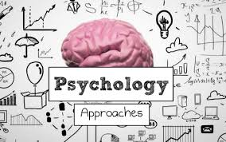
Approaches in Psychology:
Task: There are some core approaches to Psychology that you need to know for your course next year – they are different ways of explaining human behaviours.
Some of these are listed below: your job is to do some research on them using the internet (Wikipedia, while sometimes untrustworthy, is very good for this! There are also plenty of great videos on YouTube you can watch).
You should find out: what does this word mean? How might it explain human behaviour? Identify one key researcher from this area – and why are they famous?
The Behaviourist Approach
The Social Learning Theory Approach
The Cognitive Approach
The Biological Approach

Slide 14
Approaches in Psychology:
What does this Approach mean? | How does this approach explain human behaviour?
One Key Psychologist in this approach? | Why is this person famous?

Slide 15



Research task
Chose a professional from the following:
Clinical Psychologist
Couselling Psychologist
Educational Psychologist
Forensic Psychologist
Create a fact file for your chosen job role
You could include:
A day in the life of……
General roles and responsibilities
Routes into the role/ qualifications required
Skills & qualities
Average pay
Where they work
Who they work with
And anything else you think may be suitable

Slide 16

Psychology Today:
Task: Psychology is still a developing subject, with new research and information being revealed every single day. As keen young Psychologists, you need to keep abreast of new information. Twitter is seen by some to be the future of social science – it is used by researchers, academics and other social scientists alike to share news and information as well as discuss issues. I would advise that you create yourselves Twitter accounts as soon as possible and follow the below users for information and news:
@ParkHallSocSci (Park Hall Academy Social Science Department)
@PsychToday (Psychology Today magazine)
@tutor2uPsych (Tutor2U’s Psychology feed)
@ResearchDigest (The British Psychological Society’s Research feed)
@Psychmag (The Psychologist magazine)
Your second task is to keep an eye on these Twitter accounts (as well as wider sources – the news and shows on TV, newspapers and others – there are loads of fantastic movies and documentaries that you can watch for Psychology!) now and over the Summer holidays and make a note of any particularly interesting news that is relevant to Psychology.

Slide 17

Lockdown is the world's biggest psychological experiment - and we will pay the price
Currently, an estimated 2.6 billion people – one-third of the world’s population – is living under some kind of lockdown or quarantine. This is arguably the largest psychological experiment ever conducted.
The Psychology of a Pandemic:
Task:
1. Pick one of the following lines of enquiry:
  Conformity: Clapping for our NHS
  Dis/Obedience: Following Lockdown Policies
  Minority Influence: How might the UK government convince the majority to’ Stay Home’ using psychological techniques
  Consumerism: Panic buying Toilet Roll
  Mental Health: Long Term and Short Term Psychological Effects of Quarantine
2. Research your chosen line of enquiry
3. Write an article for Park Hall Academy Newsletter titled ‘COVID -19 and Lockdown – from the Perspective of a Psychologist’

Slide 18
INSERT HEADLINE
Author:
INSET IMAGE
Introduction:
Main Article:

Slide 19
If you have any further questions while you are enjoying Working From Home and your Summer holiday, my email address can be found below ☺:
Miss Vaughan
cvaughan@parkhall.org

