Slide 1
Health & Wellbeing
Help & Support Available

Slide 2
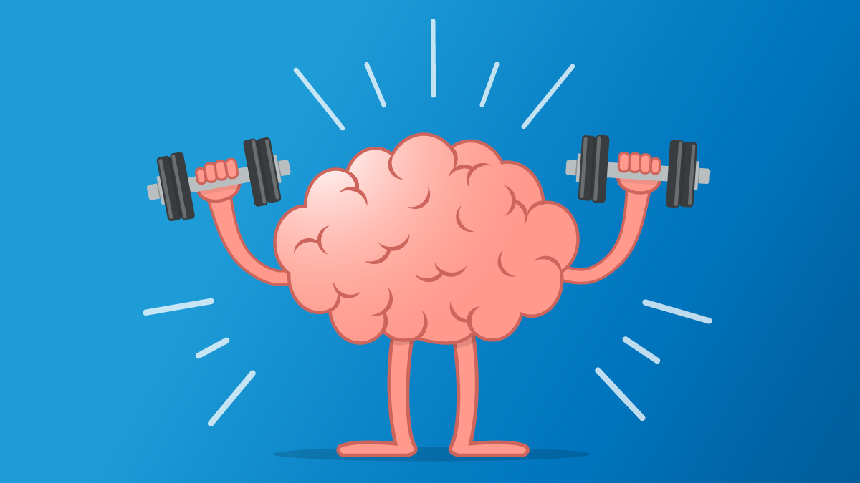
Maintaining Positive Mental Health
Look after your Physical Health (Eat well, exercise, maintain a healthy sleep pattern)
Spend some time outside every day if you can do so safely.
Take a break from Social Media (leave your phone in a different room)
Stay connected: Make time to talk to friends and family members
Share: If you are feeling down, let someone know
Create: Creative activities (art, photography, baking, writing, and scrap-booking) can be really good for mental health
Random acts of Kindness: Cooking for the family, contributing to chores can mean a lot to family members. Doing good helps us feel good.

Slide 3

Since 18th March the school and subsequently the entire country has been in a state of lockdown with restrictions now slowly starting to ease. This has meant we have all had to adapt to a new way of living and learning. This has created and enhanced anxiety levels for many of us resulting in the need for additional support both emotionally & academically.
Many of us have lost loved ones or know of people who have had Covid19 or maybe even been ill with this themselves. In addition to this families have spent more time together than they ever have and whilst for many this has been a positive experience for others it has proven stressful.
Sleep patterns and routines have been disrupted, with feelings of isolation and uncertainty about the future affecting our mental health & wellbeing

Slide 4

Where can we access support throughout the summer break?

Slide 5
There are an increasing number of ways in which to access support online some of which you can do anonymously if you feel more comfortable doing so!

Slide 6
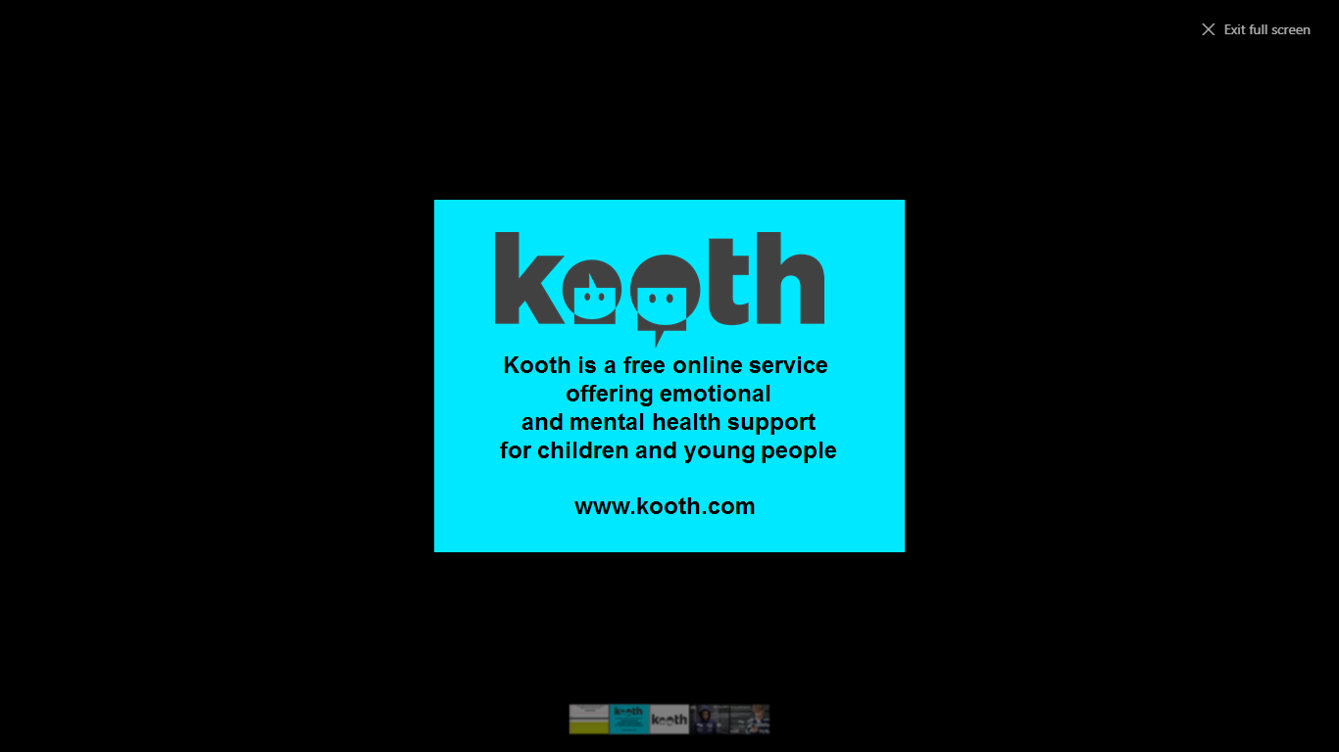

Slide 7


Slide 8
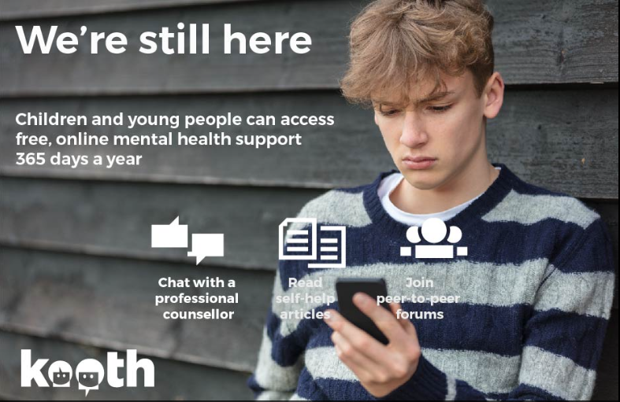

Slide 9
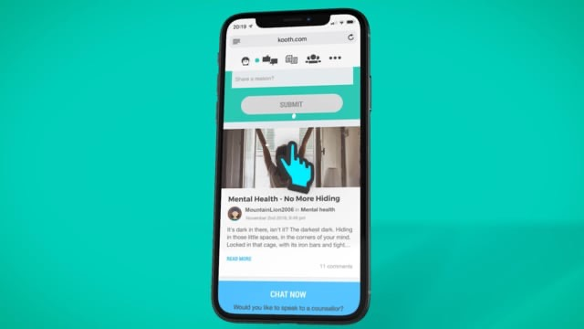
Insert video on how to access and their availability

Slide 10


Slide 11
Help with depression and anxiety
Birmingham Healthy Minds
Birmingham Healthy Minds is an NHS primary care psychological therapies service that works closely with Birmingham GPs. BHM offers advice, information and brief psychological talking therapies for people aged 16 and over, who are often feeling anxious, low in mood or depressed.
Due to the Covid outbreak, the service is currently being delivered over the phone or via a video call.
If you are already under the care of a Mental Health Team we may not be able to accept your referral to Birmingham Healthy Minds, so please speak to your Mental Health Team before you fill in the online self-referral form.
Alternatively, you can refer yourself by calling our service on 0121 301 2525.
We will be able to answer your call between 9.30am and 4.30pm, Monday to Friday. Please be patient as telephone lines can become very busy due to high demand on our service.
You can also text 'BHM' to 60777 and we will call you back*.

Slide 12
What is Support Line?
Support Line provides a confidential telephone helpline offering emotional support to any individual on any issue. The Helpline is primarily a preventative service and aims to support people before they reach the point of crisis. It is particularly aimed at those who are socially isolated, vulnerable, at risk groups and victims of any form of abuse. Support Line is a member of the Helplines Association. Support Line also provides support by email and post.
Contact Support Line on 01708 765200 or info@supportline.org.uk

Slide 13
Edwards Trust is a Bereavement Counselling Service for young people. ‘Bereavement’ relates to losing someone close to you or experiencing changes in your home circumstances as a result of changes to family members health.
They are currently available to provide support & counselling over the telephone.
We are working closely again this year with this charitable organisation to bring a counsellor trained in working with young people into school (obviously this will be wholly dependant on social distancing guidelines)
You can contact them directly on 0121 454 1705 or via email admin@edwardstrust.org.uk
Edwards Trust

Slide 14
Have a very safe
Very relaxing
Well earned break!
Please remember that talking does help, whether that be to a family member or a friend, or if you prefer, to someone independently. There is help, support & reassurance out there.
Please don’t suffer in silence, it is likely that any anxieties you are feeling are shared with many other children & young adults during these unprecedented times.
Please take care and have a happy, healthy & well deserved break and we look forward to seeing you all in September. Until we break up please feel free to contact me if you have any questions about the presentation or would like further help & guidance in accessing support. 07521 615396 or via email anorrey@parkhall.org

Slide 15
Summary of where to access help and support now and over the summer
Kooth For online support, information and counselling | www.kooth.com
Birmingham Healthy Minds (NHS) For support with Depression and Anxiety | www.bsmhft.nhs.uk Or text 'BHM' to 60777 to request a call back
Contact Support Line A confidential telephone helpline offering emotional support to any individual on any issue. | www.supportline.org.uk Phone 01708 765200 Or email info@supportline.org.uk
Edwards Trust Bereavement counselling for young people | www.edwardstrust.org.uk Phone 0121 454 1705 or email admin@edwardstrust.org.uk

