Slide 1
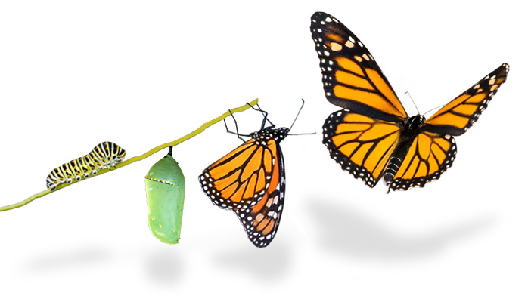
If nothing ever changed there would be no butterflies…
Welcome to Park Hall Academy for your new beginning!

Slide 2
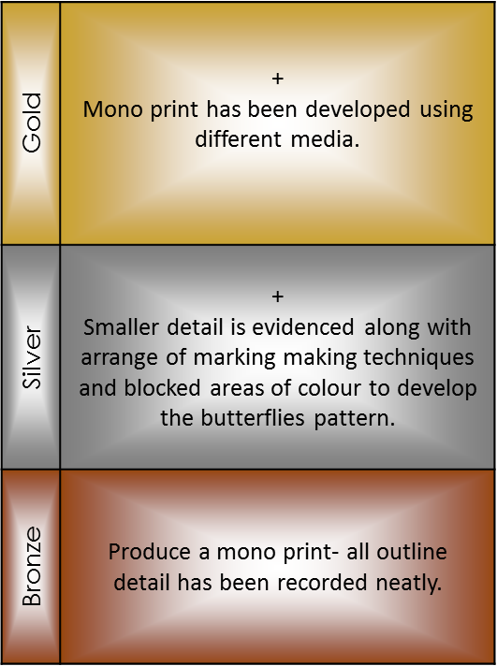
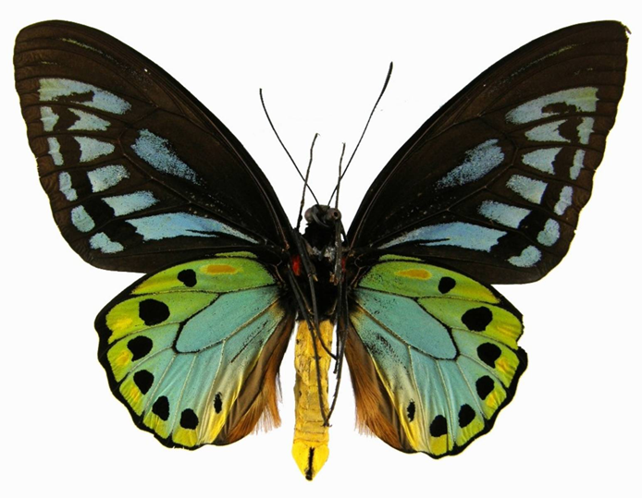
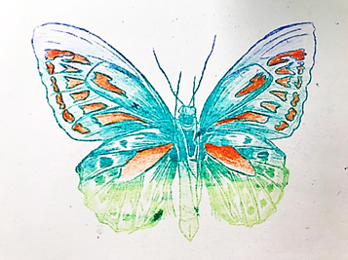
Topic: Year 6 Induction Day. Art lesson with Mrs Carlin- Head of Art and Photography.
Learning Objectives:- To manipulate sources so that I can develop media, techniques, skill and control. To learn how to mono print so that I can produce a successful image transfer.
Tasks:
1. Produce a monoprint of a butterfly.
PLTS:
Independent enquirers
Self managers.
Creative thinkers.
Key Words:
Record, Refine, Develop, Light and Dark, Tone, 3D elements, transfer
Numeracy Focus:
Proportions.
Scale
Notes:
Tli 1st side back sept
Photocopy some images for chloe to trace and work over the top of.

Slide 3
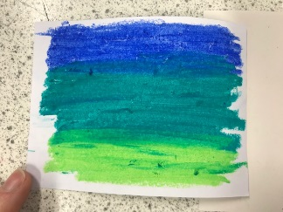
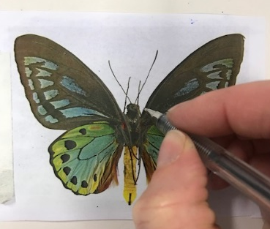
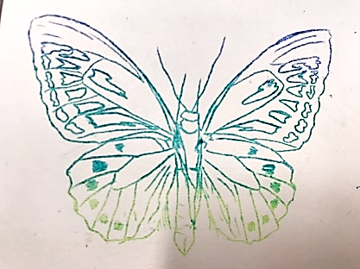
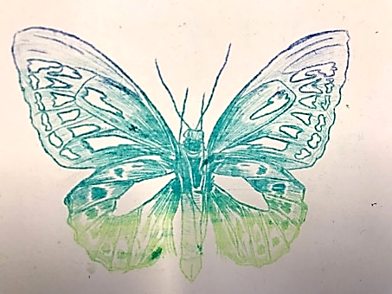
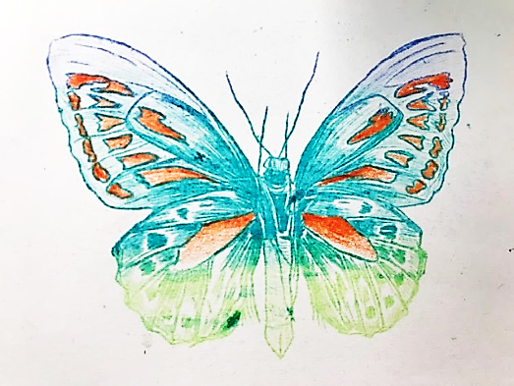
Success Criteria: For producing a mono print.
1: Apply oil pastel to the back of your image,
You can do this with one or several colours.
2: Place your paper on top of the oil pastel section.
Masking tape one edge of your image into place so that it does not move.
3: Turn over your image so that you can see the butterfly and draw over all the outline detail
until you have completed image. BRONZE.
4: Once the outline is complete check to see all he image has printed and you have all the details.
Using varying pressure on your pen start to fill in areas of your butterfly. SILVER
5. Develop your print by adding some different media. GOLD
Gold | + Mono print has been developed using different media.
Silver | + Smaller detail is evidenced along with arrange of marking making techniques and blocked areas of colour to develop the butterflies pattern.
Bronze | Produce a mono print- all outline detail has been recorded neatly.
Orange pencil crayon has been added in areas of the wings to emphasis the pattern.

Slide 4
