Slide 1
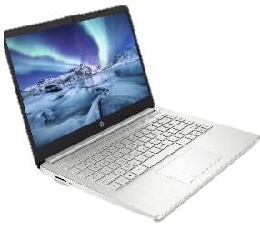
All about me
Name :
Primary School :
What I like about my school :

Slide 2
All about me
Favourite Subjects :
Hobbies :
What I like doing in my free time:

Slide 3
All about me
Favourite book :
Important people :

Slide 4
All about me
Interesting facts about you? :
Any other information:

Slide 5
All about me
Any other information:
Any other information:

Slide 6
Images that represent me

Slide 7
Images of programs that I have used in the past

