Slide 1
Welcome to Park Hall Sixth Form
A Smart Sixth Form

Slide 2
Welcome to Park Hall Sixth Form
A Happy Sixth Form

Slide 3
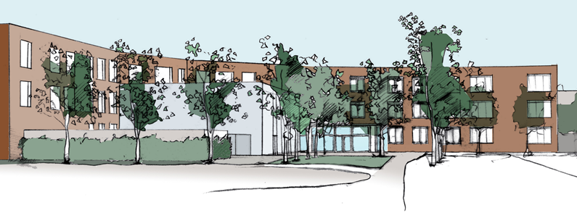
Park Hall Academy Sixth Form
Virtual Taster Day

Slide 4
Aims for the Day
Virtual taster sessions – How to find out more about the subjects on offer.
Understanding A level and Btec Grading
6th Form options revisited
How to make informed decisions when finalising my 6th form options
What does success look like?
How to market yourself (building your CV in the 6th form)
Life in Park Hall Sixth Form (Facilities, Business Dress Code, 6th Form standards, Initial Skills Assessments, Student support, Enrichment, Academy Colours)
What happens next?

Slide 5
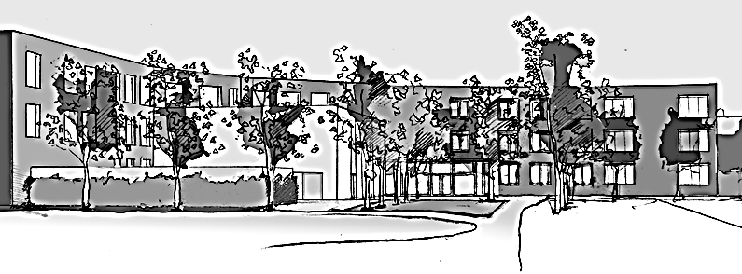
Park Hall Academy Sixth Form
1) Virtual Taster Sessions

Slide 6
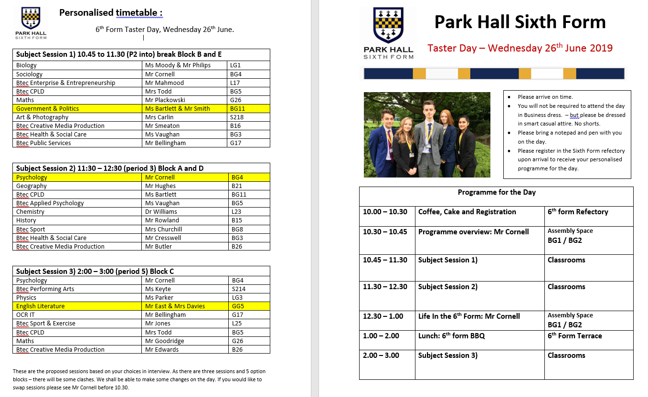
What ‘would’ our Taster Day have looked like?

Slide 7
Virtual Taster Sessions
All of our A level and Btec subjects have created induction packs that enable you to get a ‘taste’ of that subject ahead of September.
By completing these over the next few weeks you will be able to lay down a ‘foundation’ of understanding that will support your transition into the 6th form
You can access all of these taster packs via the Park Hall website (Sixth Form > Curriculum > Subject Information & Preparation) or click on the link below
Sixth Form Subject Information & Preparation

Slide 8
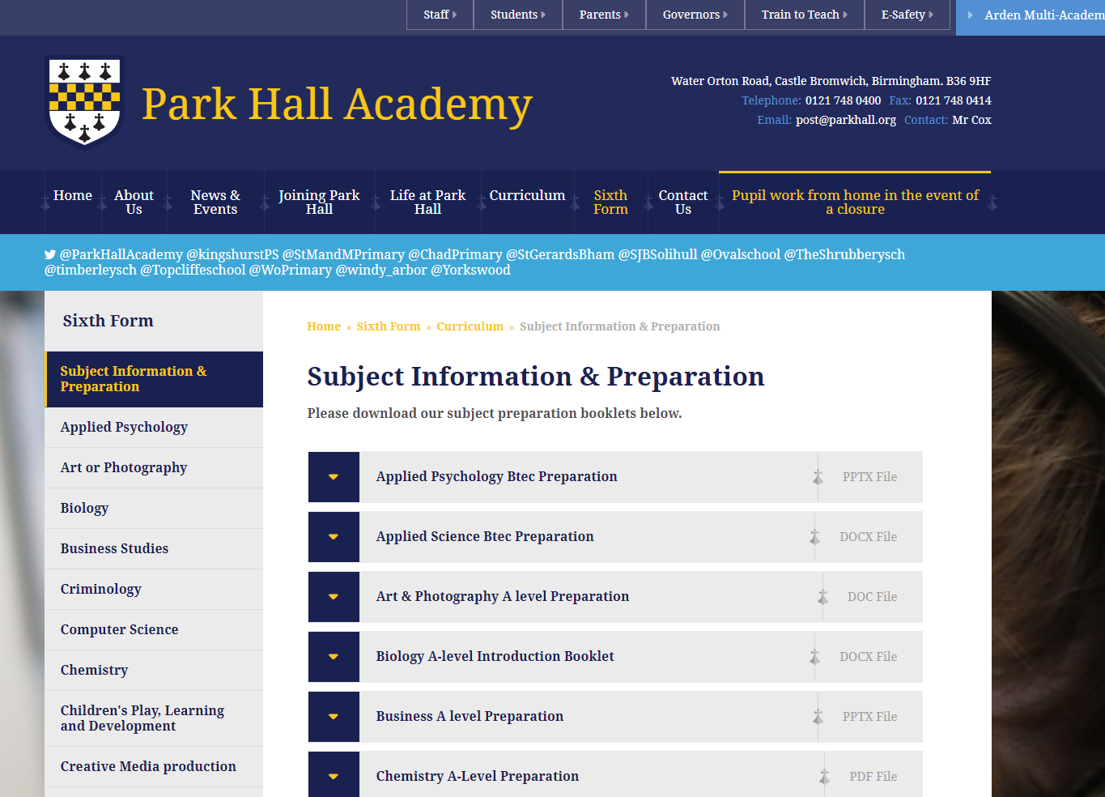

Slide 9
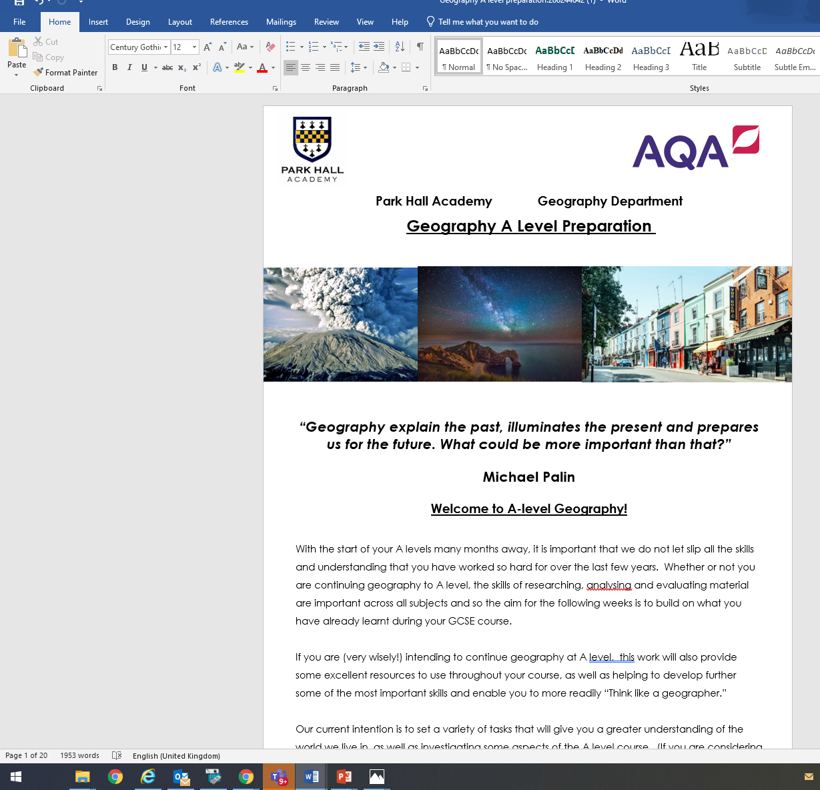
The A level Geography materials are shown as an example below.
If you are still not 100% sure about what you want to study next year – don’t worry.
These activities will tell you more about the subject and help you find out whether or not it is for you.

Slide 10
Park Hall Academy Sixth Form
2) Understanding A level & Btec grading

Slide 11
6th Form Grades
GCSE Grades | A level grades | Btec L3 Grades
8,9 | A* A B C D E | Distinction* Distinction Merit Pass
7
6
5 4
3 | U | Fail
2
1
G
U

Slide 12
Making Informed Subject Choices
An ‘average’ GCSE student would be expected to achieve 6+ GCSE’s at grade 5.
With those GCSE’s that student would be expected to gain the following grades.
Subject | Expected grade
Maths, Physics, Chemistry, Biology | E
Psychology, Business, Geography | D
Media Studies, English, History, Sociology, Politics | C
Btec Level 3 | Distinction

Slide 13
Making Informed Subject Choices
With a mixture of 6, 7, 8 and 9 GCSE grades a student would be expected to gain the following grades at A level.
Subject | Expected grade
Maths, Physics, Chemistry, Biology | C
Psychology, Business, Geography | B
Media Studies, English, History, Sociology, Politics | A
Btec Level 3 | Distinction*

Slide 14
Park Hall Academy Sixth Form
3) 6th Form Options Revisited

Slide 15
Pathway 1) Traditional A levels
* Written Examinations
* 5 x grade 5 / 5 in English and Maths
* (+6 in relevant subject)
Chemistry Biology Physics Maths Psychology Sociology Government & Politics | History Geography Art & Photography English Literature

Slide 16
Pathway 2) Level 3 Vocational (Btec)
* Coursework / External Assessment / A level style Written Examinations * 5 x grade 4 / 4 in Eng and Maths
Subject | A level Eq
Children’s Play Learning and Development | 1 & 3
Digital Media Production | 1,& 3
Sport | 1 & 2
Health & Social care | 1 & 2
Performing Arts | 1
Enterprise & Entrepreneurship | 1
IT | 1
Applied Psychology Criminology Applied Science | 1 1 1

Slide 17
Pathway 3) A level & Btec Combined
A levels | Btec Nationals
Art Chemistry Biology Physics Maths Psychology Sociology Government & Politics History Geography English Literature Photography | Children’s Play, Learning & Development Digital Media Production Sport Performing Arts IT Health and Social Care Enterprise & Entrepreneurship Applied Psychology Applied Science Criminology

Slide 18
Park Hall Academy Sixth Form
4) How to make informed decisions when finalising my 6th form choices

Slide 19
Your Success in 2022 Depends on making good decisions now.
Make Informed Decisions based on
Your strengths (based on GCSE results)
Your Interests
Your career Plan

Slide 20
Park Hall Academy Sixth Form
5) What does success
look like?

Slide 21
What does Success Look like?
Picture yourself – happy at the age of 35.
What does your life look like?
Where do you live?
Where was your last holiday?
What car do you drive?

Slide 22
Family Life
Nice Home Happy Marriage / Partnership Children in Good Schools At least 1 Family Holiday a Year Nice Family Car The latest Tech Good health Future Security (Pensions)

Slide 23
Family Life | Free & Independent
Nice Home Happy Marriage / Partnership Children in Good Schools At least 1 Family Holiday a Year Nice Family Car The latest Tech Good health Future Security (Pensions) | Renting / owning nice home Active Social Life / Latest Fashions Living in a nice area / nice lifestyle Lots of travel and holidays Cool car The latest Tech Good health Future Security (Pensions)

Slide 24
Factors that Influence Your Earnings
Education: It is well known that a degree, at least a good qualification from a reputable institution, will positively affect your salary potential. A job-hunter with a solid education can expect to come in at the higher end of the starting salary spectrum.
Experience:
The number of years you have spent in a particular role, sector or industry will have a big impact on your salary expectation. This also goes hand-in-hand with anticipated skills development.
Industry: As can be expected, salary ranges differ wildly across industries according to skills needed, demands on the employee and level of education required.
Company: Big, small, traditional, progressive… any number of attributes will play a role in how much a company values an employee or prospective employee.
Gender: In August 2018, Monster’s figures also showed the gap diminishing, with women earning an average of £25 303 and men earning an average of £30,524. (The gap is closing)
Location: London remains the beating heart of the UK’s finances and of course, its denizens can expect a hike in pay.

Slide 25
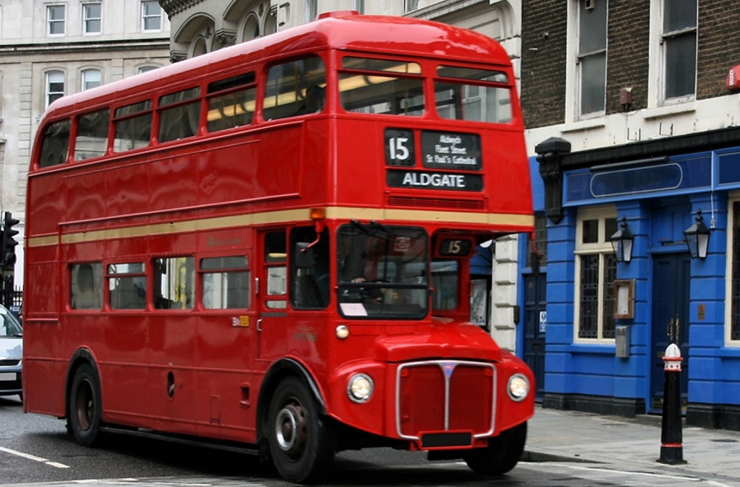
Education
Think of your education as a Bus Journey with 8 potential stops. (There are 8 ‘levels’ in the UK education system – you are currently on level 3)
At each stop – a number of people will get off the bus.
The longer you stay on the bus – the more qualifications you will achieve – and the greater your earning potential will be.

Slide 26
The Bus Starts of with 100 people on it. How many people get off at each stop?
Still on the bus
92
65
44
42
12
2
Stop 1 – 8 people get off. Leaving with no qualifications at all.
Stop 2 (GCSE’s)
A further 26 people get off here (with GCSEs only – these will include students that drop out during 6th form)
Stop 3 (A level or Equivalent)
A further 21 people get off here – having gained A level equivalent qualifications.
Stop 4 and 5 (Higher Apprenticeships and Foundation degrees)
Only a further 2 people get off here.
Stop 6 (Undergraduate Degrees)
30 people get off here, having achieved degree level qualifications that give them access to the best paid jobs.
Stop 7 (Masters Degree, PGCE etc)
12 people get off after post graduate studies
Stop 8 (Phd) 2 people stayed on till the very end

Slide 27
Achieving Level 3 is the key to accessing levels 4 to 8 and higher earning jobs.
Once you have achieved level 3 qualifications you can hop on and off the bus whenever you like.
Success at level 3 – is dependent upon choosing the right courses for you.

Slide 28
Park Hall Academy Sixth Form
6) Marketing Me

Slide 30
What is ‘Marketing Me’?
Engaging with a culture of Aspiration
Aiming High
University / Russell Group University / Level 4 Apprenticeship
Seeking and Taking Opportunities
Knowing how to ‘sell yourself’
What you do outside of the classroom
How do you show your passion for learning (reading / researching / visits / documentaries / work experience / volunteering)

Slide 31
How can I use my time in the Sixth Form to market myself?
Volunteer at PH (mentoring younger students, coaching sports teams)
Volunteer outside of PH (NHS Young Volunteers
Represent (6th form Executive)
Participate (Trips, Envision Programme, Sports Teams, Social Mobility Foundation)
Work Experience (Plan ahead for June 2021)
Read (Build up a reading list in your specialist subject)
Explore Online (Mooc Courses, Youtube Documentaries, UCAS)
Listen (Podcasts are a great way to broaden your horizons – listen while you are on the move_
Create (your own film, blog, portfolio)

Slide 32
Park Hall Academy Sixth Form
7) Life In Park Hall
Sixth Form

Slide 33
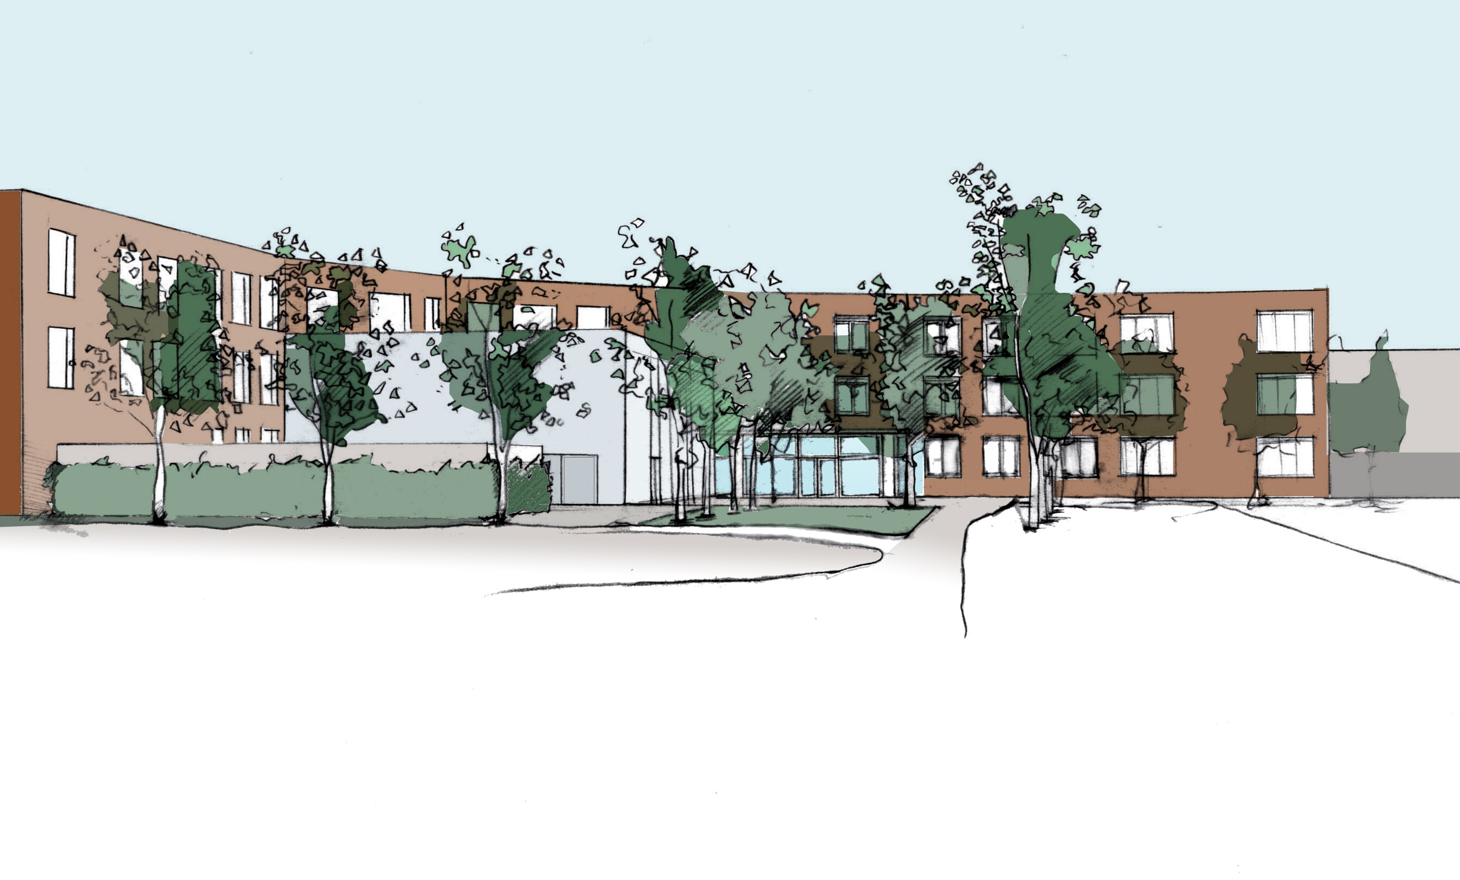
What do I need to know …
.… about life in the Sixth Form at Park Hall?

Slide 34
New facilities & Independence…

Slide 35
Business Dress Code
For Boys
Grey , Navy or Black Suit
Plain Collared shirt – light colour (white, light blue or pastels)
Tie
Black or brown polished shoes
For Girls
Grey, Navy or black skirt or trouser suit or
Plain Grey, Navy or Black dress with matching jacket.
Tailored, plain work blouse.
Black, navy, brown or grey polished shoes.

Slide 36
Guiding Principles
Outdoor Coats and hats must not be worn in the academy.
No Denim / Leather Jackets
Girls - all skirts and dresses to be knee length. No low cut, sheer, strappy or crop tops.
Students that do not follow the dress code will be required to go home to change.
Bursary students will be able to claim an £80 advance once enrolled and Bursary application is processed.

Slide 37
6th form Standards
Attendance (minimum expectation of 95%)
Online Engagement using Microsoft Teams (Log on every day, maintain a work routine, submit work on time)
Punctuality (attendance to form every morning)
Mobile Phones (Refectory, study room & 6th form terrace only)
Homework (Bring planner every day, meet deadlines, expect 2 – 3 hrs per week day evening)
Study Periods (Make use of study time)
Folder Organisation (Folder for every lesson. All handouts, notes and assessments kept in order)

Slide 38
Initial Skills Assessment
An important assessment will take place in the first 3 weeks of every course.
This is to check your suitability to the course and identify where you may require additional support.

Slide 39
Where Can I access support?
Ms Norrey: 6th Form Office
Or any member of the 6th Form team
anorrey@parkhall.org
icornell@parkhall .org

Slide 40
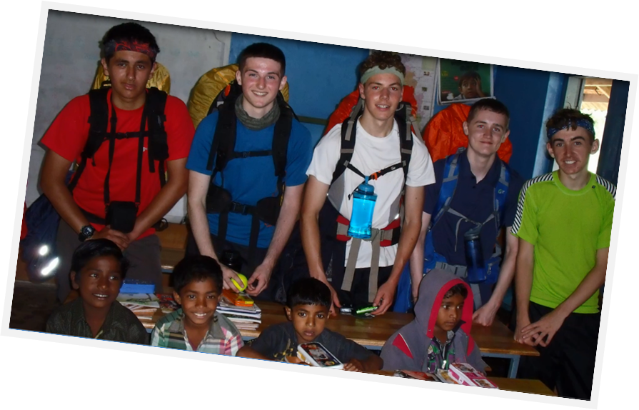
Enrichment & Employability

Slide 41
Academy Colours
Achieving Academy Colours demonstrates dedication above and beyond the normal commitment of a student, making you ‘stand out from the crowd’ and supporting your applications to universities, training providers and employers.
Working towards your Academy Colours will also help you develop as a person in terms of self confidence, personal drive and initiative.

Slide 42
What Qualities Do I Need To Demonstrate?
Commitment, Dedication & Reliability
1)
Demonstrated by…
Attendance record above 95%
Punctuality record (0 lates)
No referrals for non completion of work

Slide 43
What Qualities Do I Need To Demonstrate?
2)
Leadership
Demonstrated by …
Form tutor commendation for participation in form
Supporting a school event (eg. 6th form Information Evening, Open Evening, Y7 induction).

Slide 44
What Qualities Do I Need To Demonstrate?
3) Social Responsibility
Demonstrated by …
Full participation in the year 12 Enrichment programme and completion of all written records.
Raising at least £25 through a fundraising event
Supporting fellow students (eg. buddy reading scheme, supporting PE lessons, peer mentoring, academy council, student union executive)

Slide 45
What Qualities Do I Need To Demonstrate?
4) Achievement
Demonstrated by …the following are compulsory requirements)
Grades C and above in GCSE Maths and English by the end of year 12
The achievement of all baseline target grades at the end of year 12

Slide 46
What Qualities Do I Need To Demonstrate?
5) Completing an Outstanding Personal Challenge
This will be unique and personal to you and may be completed inside or outside of school. Examples include…..
Organising an event
Raising awareness of an issue (eg by planning and delivering a school or sixth form assembly)
Raising over £100 through a personal challenge (eg sponsored swim, bike ride, run, book sale)
Volunteering in your spare time (eg as a dance teacher , scout leader)
Achievements as part of your role on the Student Union Executive.

Slide 47
Aspiration
Dream Big
&
Aim High
+
Back Yourself
(Create opportunities & Take Opportunities)

Slide 48
Park Hall Academy Sixth Form
8) What Happens next?

Slide 49
What Happens Next?
Date | Event | Detail
Thursday 20th August | GCSE Results Day | To be confirmed
Friday 21st August | 6th form enrolment day | To be confirmed
September 2020 | First Day – Induction | To be confirmed
If you can’t make Enrolment Day please e mail your options to anorrey@parkhall.org

