Slide 1
Welcome to
Notes:
Welcome to Park Hall Academy
Hi my name is Mr Sanghera and I teach Computer science to all the years
Today you we will get to know more about you and what you are interested in.

Slide 2
Your task today
Create an All about me presentation
This will be given to your year 7 form tutor.
You will see your form Tutor every Monday, Tuesday, Thursday and Friday morning.
Notes:
At Park Hall you will each have a Form tutor for you group. Who you will see on Monday, Tuesday, Thursday and Friday mornings
Your form tutor is really looking forward to meeting you.
Our task for you today is to make an All about me presentation, to help introduce yourself to your new form tutor
In this presentation you will include any information about yourself that you feel would be good for them to know.

Slide 3
Information to include :
Name:
Your primary school:
Favourite subject at school:
Hobbies and what you like doing in your free time:
You should include any information to help your tutor know you better
Notes:
You should include your
Name
current primary school
Favourite subjects
Any hobbies and interest that you may have
What you like to do in your free time

Slide 4
Information to include :
Favourite book you like to read:
Important people in your life:
Interesting facts about you?
Is there any questions you have about starting Park Hall Academy?
You should include any information to help your tutor know you better
Notes:
Your should include your
Favourite book that you have read, you can include more than one book
Interesting facts about yourself, like do you have any pets, you play sports for a teams, tricks you know how to do
We have also given you space to complete any additional information that you find interesting that you wold like us to know

Slide 5
ICT Skills you can show
Using the Internet
Transitions
Gold
Text
Colour
Copy and paste
Saving file
Images
Background colour /Styles
Animation
Silver
Bronze
Notes:
For this task I’m hoping to see as many of the skill listed on screen
For Bronze
You will show that you have typed in to the correct boxes
Added colour to the slide, text or background
You may have used copy and past
And you can safely save a file
~For silver You will have used images, from clipart or the internet
Changed background style of colours
Added animations on to some text or images
For gold
You have use the internet to gather information or images
Used transitions to go from one slide to the next from the transition menu at the top

Slide 6
All about me
Name :
Primary School :
What I like about my school :

Slide 7
All about me
Favourite Subjects :
Hobbies :
What I like doing in my free time:

Slide 8
All about me
Favourite book :
Important people :

Slide 9
All about me
Interesting facts about you? :
Any other information:

Slide 10
All about me
Any other information:
Any other information:

Slide 11
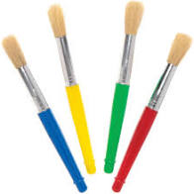
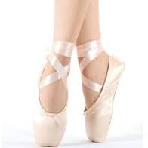
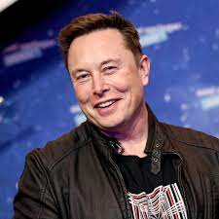
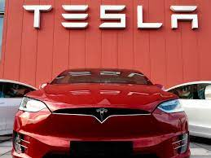
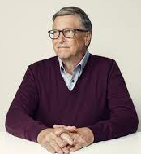
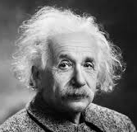
Images that represent me

Slide 12
Images of programs that I have used in the past

Slide 13
Look forward to meeting you all in September!

